Slide 1
2012 Wholesale Banking Global Peer Review
WB Performance Management
March 2013
Notes:
1

Slide 2
Contents
WB Equivalent Overview
Slide 3: Executive Summary
Slide 4-5: FY’12 WB-Equivalent Total Income
Slides 6: WB-Equivalent Total Income Volatility
Slide 7: WB-Equivalent Total Expenses and Expense JAWs
Slide 8: WB-Equivalent Cost Income Ratio
Slide 9: WB-Equivalent Impairment
Slide 10: WB-Equivalent Operating Profit
Slide 11: WB Equivalent Global Peer Group Performance Summary
WB Equivalent Product Drill Down
Slides 13-20: Transaction Banking and Lending
Slides 22-27: FXRC & Commodities
Slides 29-31: Corporate Finance and Capital Markets
Balance Sheet Metrics
Slide 33: Growth in Peer Group Core Tier 1 Ratios
Slide 34: European Bank Deleveraging Activities
Slide 35: UBS Deleveraging Deep Dive
FX & Investment Banking League Tables
Slides 37-44: FY’12 FX & Investment Banking League Tables
WB Equivalent Methodology and Assumptions
Slide 46: WB Equivalent Methodology and Assumptions

Slide 3
Executive Summary
  2012 was characterised by many peers posting a FXRC&C recovery on a very poor 2011, while several European banks continued aggressive deleveraging. Cost growth ex fines etc was moderate to declining.
  FY’12 WB equivalent income (ex-CVA/DVA) rose +9% YoY (H1’12: -6% YoY) on average across the peer group driven by FXRC&C (+21% ex-CVA/DVA),Transaction Banking (+7%) and Capital Markets (+7%), partially offset by decline in Equities (-7%) and Corporate Finance (-8%). SCB delivered equivalent income growth of +9% YoY driven by Transaction Banking, Corporate Finance, Capital Markets and Principal Finance.
  Goldman Sachs reported the strongest growth (+26%) YoY, with double digit growth across all WB Equivalent businesses for FY’12 except for Equities (-2% YoY) and Corporate Finance (-1% YoY).
  SCB’s FY’12 Transaction Banking performance was strongest amongst peers with growth of +13% YoY¹ versus an average of +7%, due to a +18% growth in Trade Finance and a +7% growth in Cash Management.
  Peer group FXRC&C income recovered strongly in FY’12 (up +21% YoY ex-CVA-DVA) driven by Rates and Credit. The recovery followed a weak performance in prior year with the lowest FXRC&C income since pre-GFC. In contrast, SCB reported its highest ever FXRC&C income in the prior year, and a -2% YoY decline in FY’12 FXRC&C income.
  FY’12 Corporate Finance and Equities Income declined YoY across the peer group driven by lower M&A deal volumes and lower market equity volumes and a low volatility environment. SCB was the only bank to report FY’12 YoY growth in both businesses (+13% for Corporate Finance¹ and +18% for Equities²).
  Peers reported further cost savings and/or job cuts in Q4’12. FY’12 Expense growth YoY were broadly flat (+1%), driven by lower staff costs, which was offset by higher litigation and regulatory costs. Peers reported positive YTD Expense JAWs of +8%YoY and cost:income ratio of 64% (FY’11: 69%).
  Operating Profit ex-CVA/DVA rose +23% YoY on average for FY’12 driven by an uptick in income, coupled with broadly flat expenses growth.
Sources: Company reports, WB Performance Management analysis.
¹ External basis
² Management basis
Notes:
3
3

Slide 4
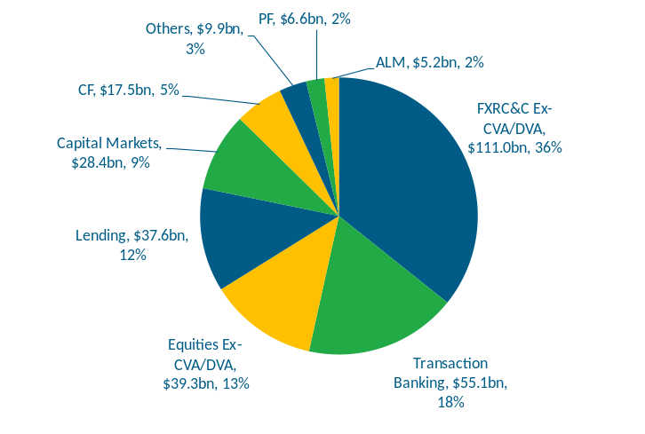
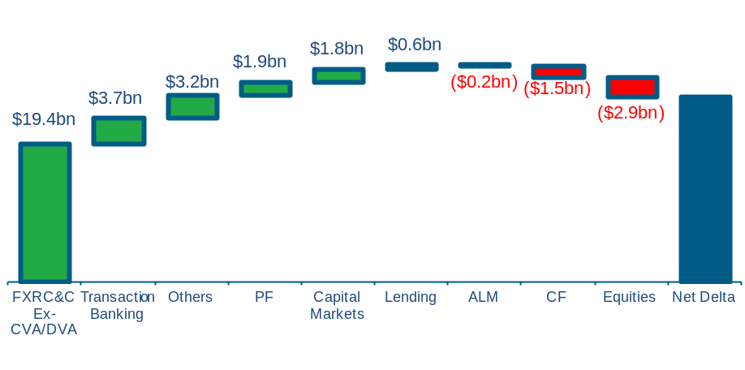
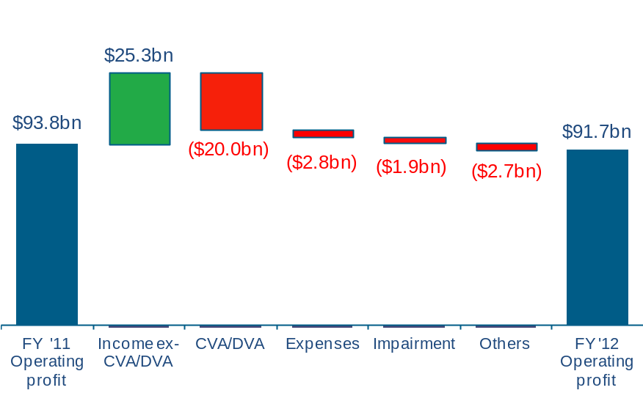
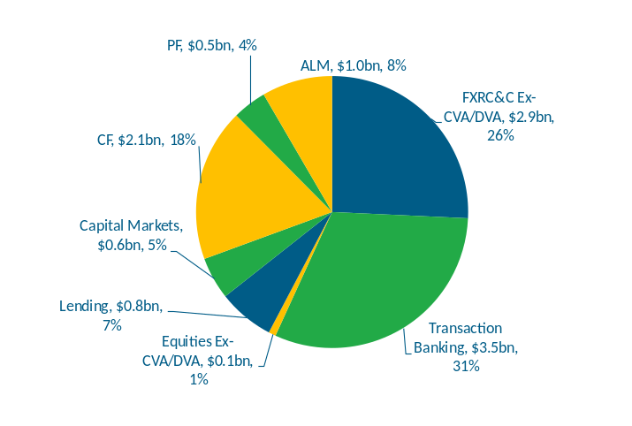
FY’12 aggregate WB Equivalent Income rose +9% YoY to $311bn primarily due to strong growth in FXRC&C
Aggregate WB Equivalent FY’12 Income Split¹
FY’12 YoY Aggregate Income Delta
Total Income: $311bn
$26.0bn
+9%
SCB WB Equivalent FY’12 Income Split
FY’12 YoY Aggregate Operating Profit Delta
Total Income: $11.4bn (3.7% of Global Income Pool)
FY’12 YoY: ($2.1bn), (2)%
1
2
Sources: Company reports, WB Performance Management analysis. SCB product split on management basis.
  ¹ CVA/DVA excluded from BoA, Citi, Credit Suisse, Goldman Sachs, JPMC, Morgan Stanley and UBS. No CVA/DVA disclosure available for Barclays, BNP Paribas, Deutsche Bank, RBS and SocGen.
  2 Others relate to JV and associate income. HSBC & SG disposed of some of their JV’s in FY’12.
Notes:
4
4

Slide 5
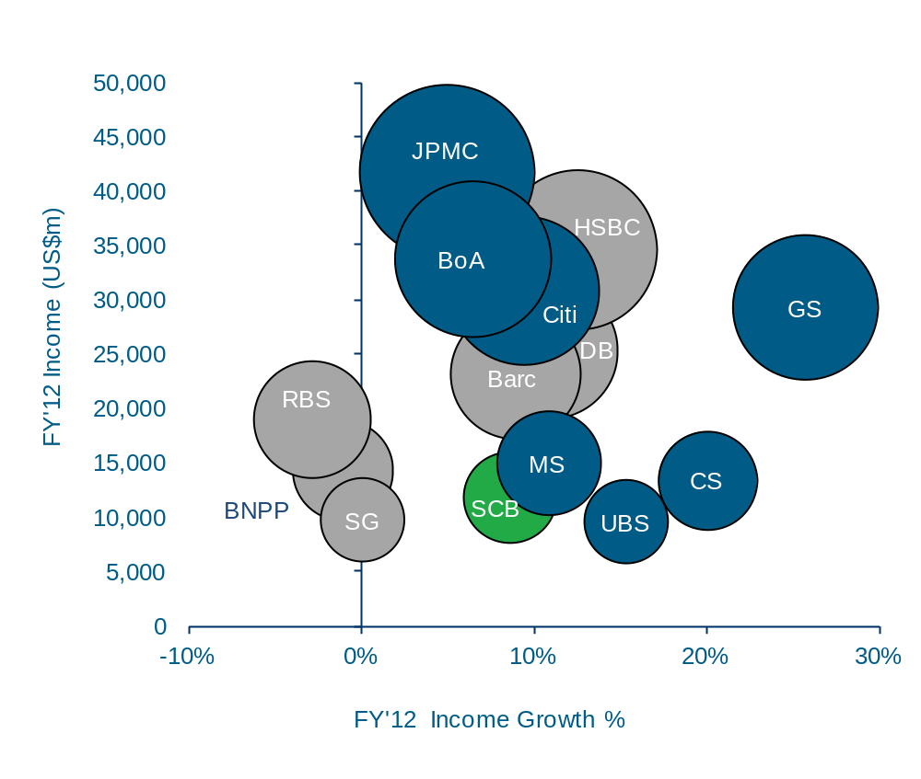
SCB’s FY’12 Income growth of +9% was in line with the average growth of +9% YoY across peers
WB-Equivalent Income: FY’12 Ex-CVA/DVA
($m and YoY %, Bubble size scaled to FY’12 WB-Equivalent Income)
Highlights
Note: Blue shading indicates figures excluding CVA/DVA
  Peers’ average FY’12 WB-Equivalent Income grew +9% YoY. SCB WB Income growth of +9% was driven by Transaction Banking, Corporate Finance, Capital Markets and Principal Finance, partially offset by FXRC&C.
  FY’12 WB-Equivalent Income growth for most peers was driven by a strong recovery in FXRC&C from a low FY’11 base (+21% ex-CVA-DVA), and Transaction Banking (+7%), partially offset by decline in Equities (-7%) and Corporate Finance (-8%).
  Goldman Sachs WB Equivalent Income of $29bn (ex CVA/DVA) was up +26% YoY driven by significant gains in its Investing & Lending business and a rebound in FXRC&C income.
  HSBC’s WB-equivalent income growth of +12% was driven by a rebound in its FXRC&C business coupled with continued growth in transaction banking (+11% YoY).
  Income growth at the French banks (BNPP -1%, SocGen 0%) and RBS (-3%) lagged the peer group, impacted by the deleveraging of their WB-equivalent businesses.
FY12 Average YoY Income Growth: +9%
SCB figures on external basis
CVA/DVA excluded from BoA, Citi, Credit Suisse, Goldman Sachs, JPMC, Morgan Stanley and UBS. No CVA/DVA disclosure available for Barclays, BNP Paribas, Deutsche Bank and SocGen.
Notes:
5
5

Slide 6
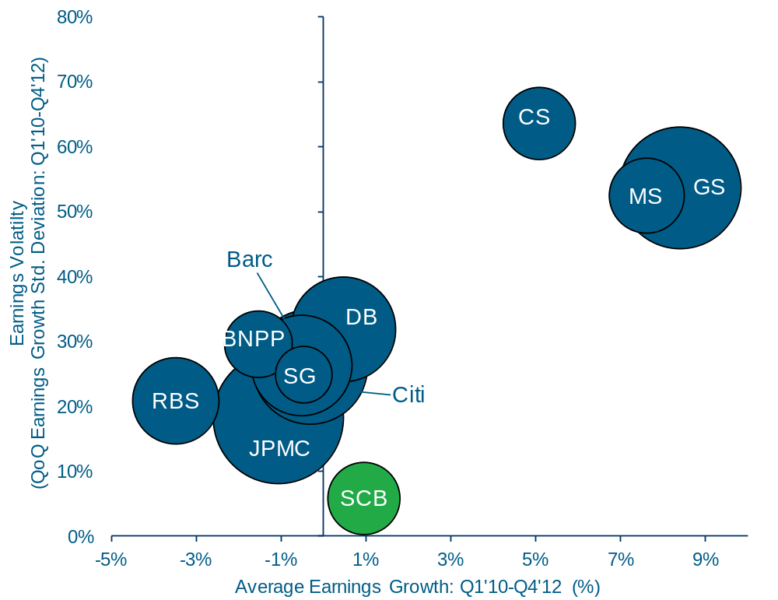
SCB has delivered superior income growth since Q1’10 at the lowest level of volatility of the peer group
WB-Equivalent Income growth and volatility: Q1’10–Q4’12
(Std. Deviation and YoY %, Bubble size scaled to FY’12 WB-Equivalent Income)
Highlights
Note: All peer figures include CVA/DVA
  SCB QoQ income growth volatility (6%) was the lowest amongst peers between Q1’10 and Q4’12. Despite this, average QoQ earnings growth (+1%) was above average and FY’10-12 income CAGR of +9% was the highest in the peer group.
  Volatility was significantly higher among the four peers whose WB equivalent income comprises Global Markets businesses only –Credit Suisse (63%), Goldman Sachs (54%) and Morgan Stanley (52%) and UBS¹ (45% exc. Q3’11 trading loss). Swiss banks earnings volatility was impacted by fluctuations in the Suisse franc over the period.
  There was close grouping of volatility levels amongst other peers, with all banks’ standard deviation falling within the range of 18% (JPMC) to 32% (Deutsche Bank).
  Notes: Standard deviation calculated as the mean distribution from the mean QoQ income growth for each bank over the period. The higher the standard deviation, the more volatile the earnings growth.
  HSBC and BoA excluded as no quarterly disclosure available for 2010 on consistent basis. Based on Q1’11-Q4’12 period, HSBC earnings volatility was 0.14 with average QoQ earnings growth of +1%.
Sources: Company reports, WB Performance Management Analysis. SCB FY’10-12 earnings CAGR on external basis, with quarterly earnings volatility on management basis.
All peer figures include CVA/DVA as disclosure limitations do not permit consistent analysis over the period on an ex-CVA/DVA basis
¹ UBS excluded as average QoQ earnings growth and earnings volatility distorted by trading loss in Q3’11
Notes:
6
6

Slide 7
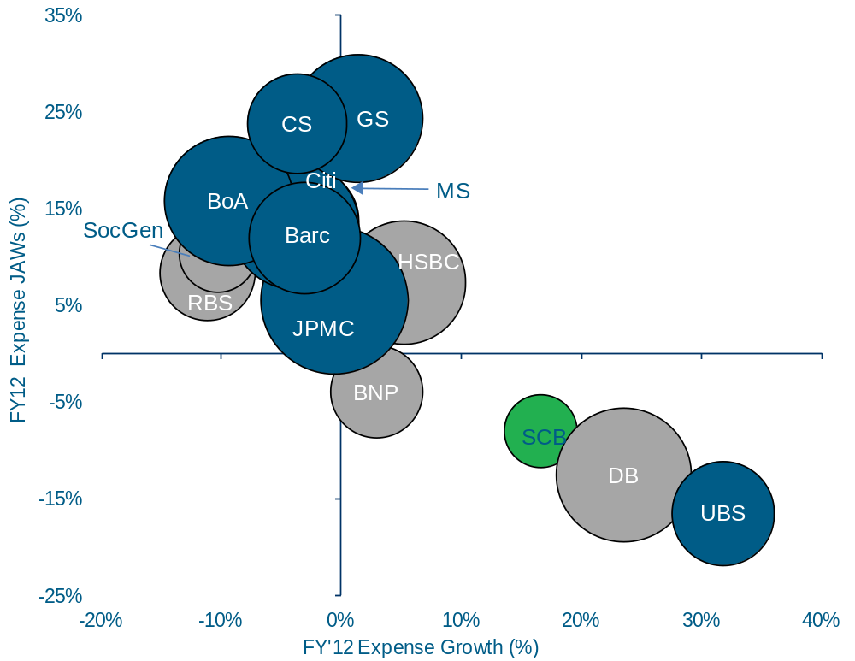
FY’12 expense growth increased slightly across the peer group with most banks reporting positive expense jaws
FY’12 WB-Equivalent Expense Growth vs. WB-Equivalent JAWs
(%, Bubble size scaled to FY’12 WB-Equivalent Expenses)
Highlights
Note: Blue shading indicates figures excluding CVA/DVA
  Average FY’12 expense increased slightly YoY (+1%) across the peer group. More than half reported lower expenses from controlled compensation and cost saving initiatives.
  Performance was varied geographically as US peers excl. GS reported lower YoY expenses mainly as a result of lower compensation costs while European peers, UBS, BNPP, DB and HSBC reported higher expenses (principally driven by restructuring and litigation costs/regulatory fines) compared to RBS, Barclays, CS and SocGen whose expenses declined mainly from lower compensation costs and cost efficiency.
  Average FY’12 expense jaws were +7% YoY with GS’ jaws of +24% the highest among peers, followed by CS (+24%), which were driven by higher than average income growth.
  UBS and DB reported YoY negative jaws as cost growth from restructuring and litigation more than offset revenue growth. BNPP’s negative jaws was attributed to lower revenues combined with higher costs from investments and restructuring.
FY’12 average YoY expense: +1%
FY’12 average YoY expense jaws: +7%
Figures include US regulatory settlements. Excluding US regulatory settlements, SCB FY’12 YoY Expense growth was +2%, with JAWs of +7%
Sources: Company reports, WB Performance Management Analysis. SCB figures on external basis.
CVA/DVA excluded from BoA, Citi, Credit Suisse, Goldman Sachs, JPMC, Morgan Stanley and UBS. No CVA/DVA disclosure available for Barclays, BNP Paribas, Deutsche Bank, RBS and SocGen. HSBC excludes CVA/DVA but includes EL charge.
Notes:
7
7

Slide 8
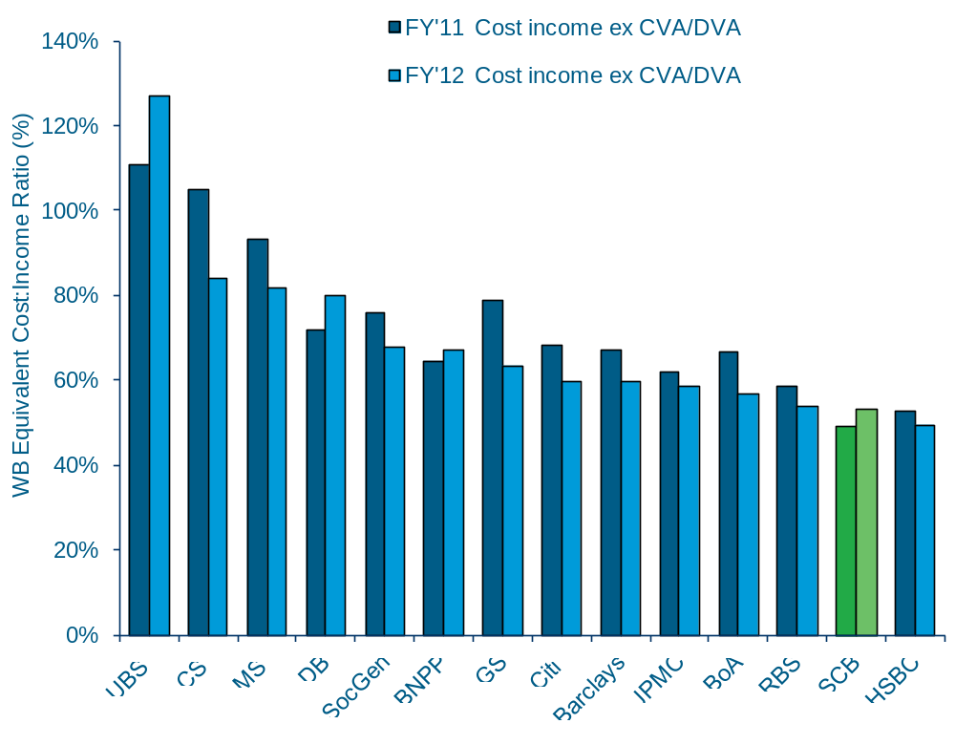
HSBC reported the lowest cost:income ratio in the peer group for FY’12, followed closely by SCB
WB-Equivalent Cost:Income ratio: FY’11 and FY’12
Highlights
  FY’12 Cost:Income ratio for the peer group fell to 64% (FY’11: 69%), driven by income growth of +9% coupled with a +1% increase in Expenses for the peer group.
  HSBC reported the lowest Cost:Income ratio of 49%, followed closely by SCB. Excluding the DFS settlement, SCB Cost:Income ratio fell to 47%.
  UBS, Credit Suisse and Morgan Stanley continued to report Cost:Income ratios significantly higher than average at 127%, 84% and 82% respectively.
  The US banks average expenses declined by -3% YoY driven by a reduction in staff cost and other expense reduction initiatives, resulting in a strongly positive JAWS of +13%.
  Peers reported ongoing job cuts and shrinking their investment banking divisions, either as part of their cost-savings initiatives or meeting the more stringent regulatory requirements in reducing their RWAs.
FY12 Average
Cost:Income Ratio: 64%
CVA/DVA excluded from BoA, Citi, Credit Suisse, Goldman Sachs, JPMC, Morgan Stanley and UBS. No CVA/DVA disclosure available for Barclays, BNP Paribas, Deutsche Bank, RBS and SocGen.
Notes:
8
8

Slide 9
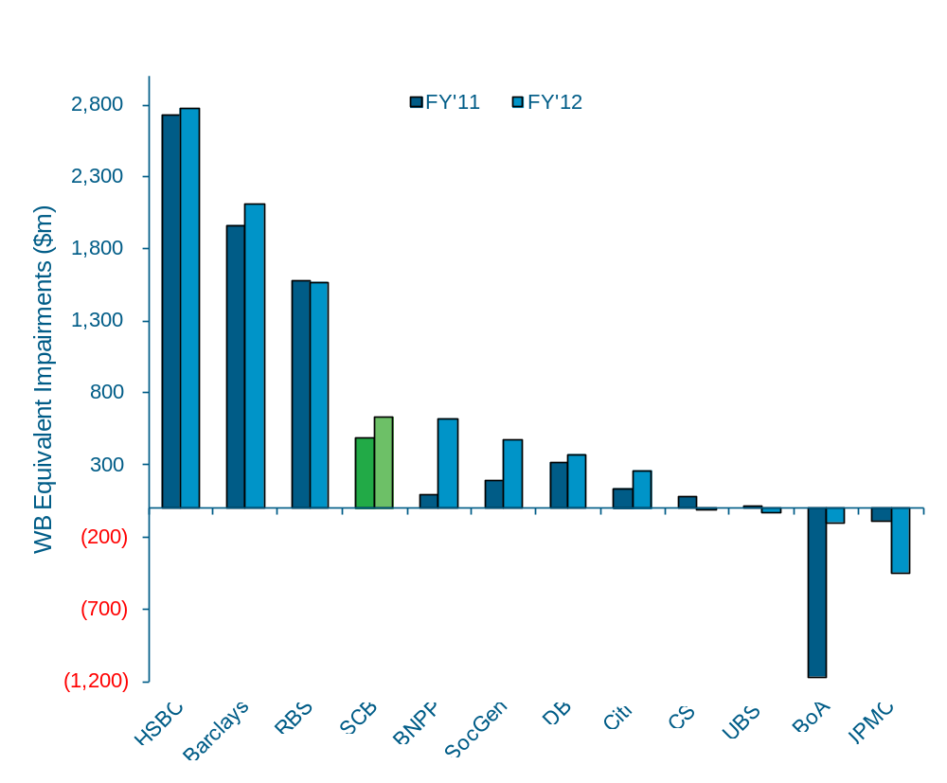
WB Equivalent impairments rose across the peer group driven by increased specific provisions and reduced releases compared to FY’11
WB-Equivalent Impairments charges: FY’11 and FY’12
($m, %)
Highlights
% of WB Income
ex-CVA/DVA
8%
9%
8%
5%
4%
5%
2%
1%
0%
0%
0%
-1%
  The majority of the peer group reported a FY’12 YoY increase in WB Equivalent impairments, driven by increases in specific provisions and lower releases than in 2011.
  HSBC continued to report the highest level of impairments ($2.8bn, up +2% YoY) driven by individual charges, as well as an increase in impairment charges in the Bank’s legacy credit business.
  Barclays’ impairments rose +7% YoY to $2.1bn driven by legacy CDO assets, higher losses on single name exposures and release of provisions from FY’11 not repeated in FY’12.
  BNPP impairments rose $528m compared to FY’11 when it was particularly low due to substantial write backs.
  JPMC reported a credit cost benefit of $445m driven by recoveries and a reduction in the allowance for credit losses on restructured NPLs.
FY’12 YoY
+Better/(Worse)
(2%)
(7%)
+1%
(31%)
n/m
(149%)
(17%)
(88%)
+116%
n/m
(91%)
n/m
Sources: Company reports, WB Performance Management Analysis.
Note: Goldman Sachs and Morgan Stanley excluded from analysis as no impairments reported.
Notes:
9
9

Slide 10
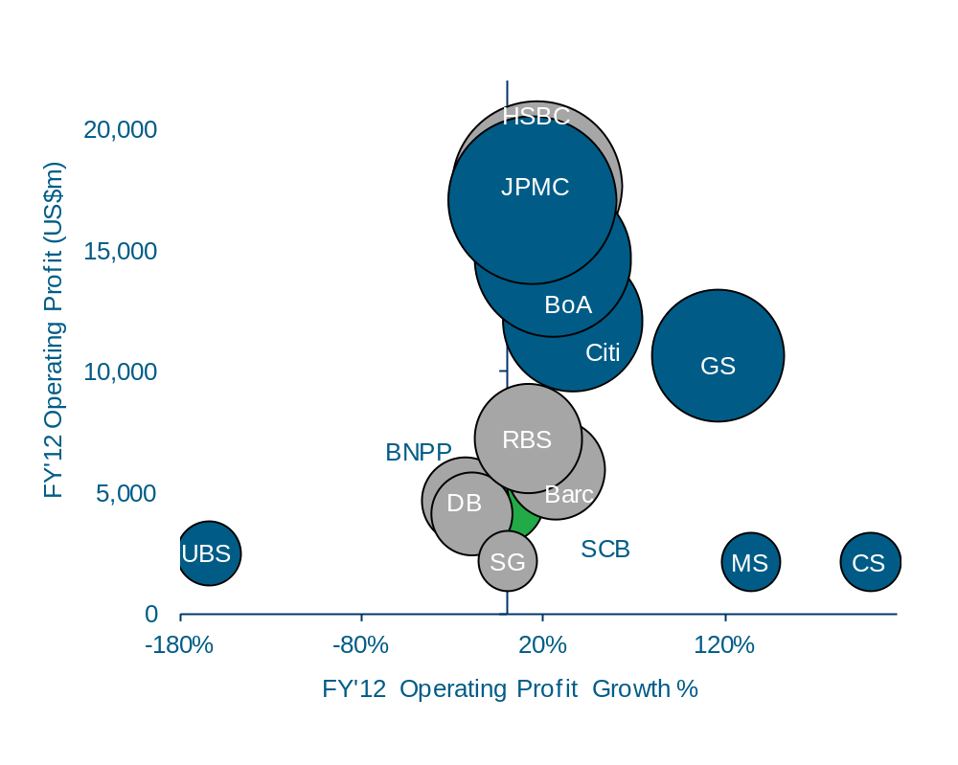
Peer group average FY’12 Operating Profit growth increased +22% YoY, driven by income growth and broadly flat expenses
WB-Equivalent Operating Profit: FY’12 Ex-CVA/DVA
($m and YoY %, Bubble size scaled to FY’12 WB-Equivalent Operating Profit)
Commentary
Note: Blue shading indicates figures excluding CVA/DVA
FY’12 Average YoY Operating Profit rose: +22%
  FY’12 Operating Profit ex-CVA/DVA rose by an average +22% across the peer group, driven by income growth and broadly flat expenses.
  Excluding the DFS settlement, SCB’s FY’12 Operating Profit rose +11% YoY.
  GS, MS and CS had income growth of +26%, +11% and +20% respectively, coupled with positive Expense JAWs of +27%, +8% and +16%, resulting in Operating Profit growth of +116%, +134% and +437%.
  BNPP’s Operating Profit decline was driven by negative cost:income JAWs coupled with increased Impairments.
  UBS reported income growth of +7% which was offset by high expense growth of +32%, resulting in an annual loss (ex-CVA/DVA) of $2.5bn compared to a loss (ex-CVA/DVA) of $0.9bn in FY’11.
440%
Sources: Company reports, WB Performance Management Analysis.
Notes:
10
10

Slide 11
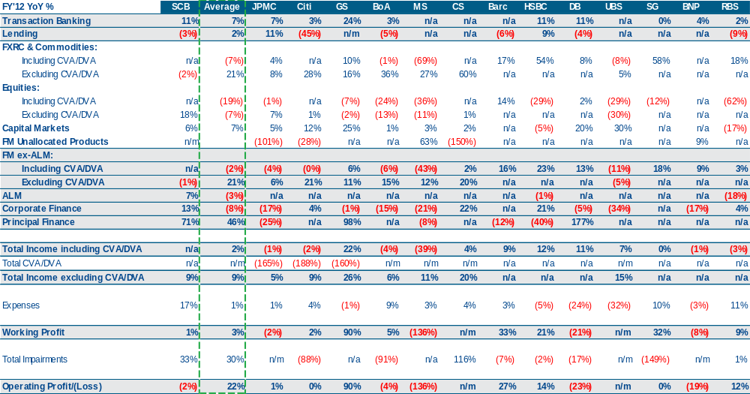
WB Equivalent Global Peer Group: FY’12 YoY Performance Summary
1,2
Sources: Company reports, WB Finance analysis.
¹ All headline SCB figures on external basis; all SCB product figures on management basis
² SCB figures include effects of US regulatory settlements. Excluding these SCB FY’12 YoY expense growth was +2%, and FY’12 operating profit growth was +11%
Averages based on total peer group (inclusive of SCB) income. Cells denoted “n/a” when data not available, and “n/m” when YoY% change greater than 200% or less than -200%

Slide 12
WB Equivalent Product Drill Down
Transaction Banking

Slide 13
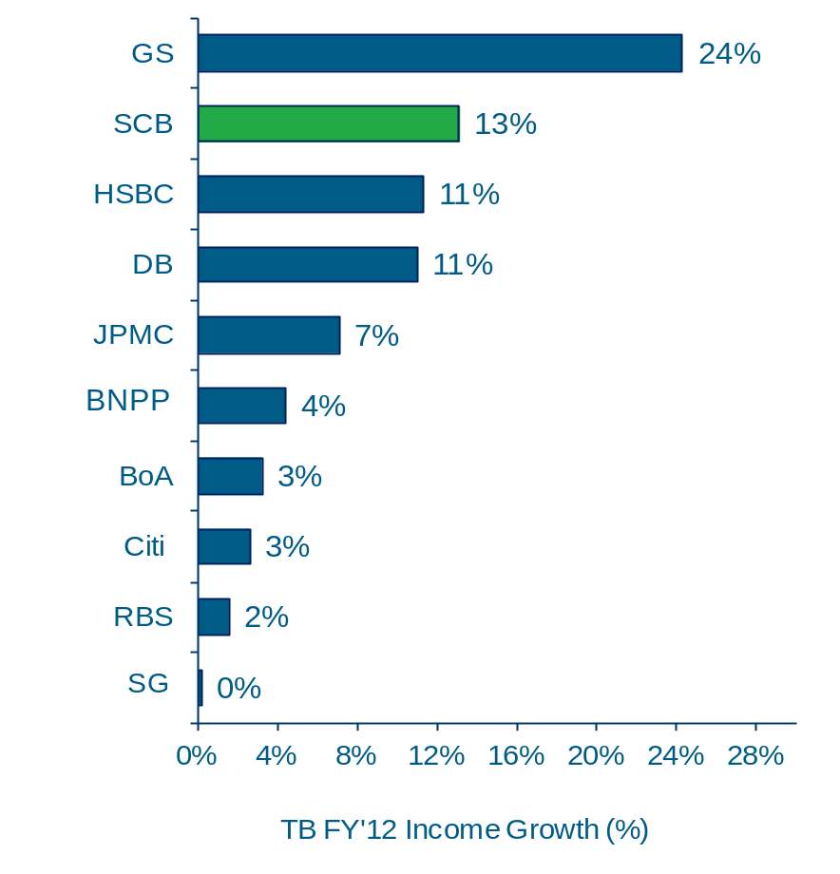
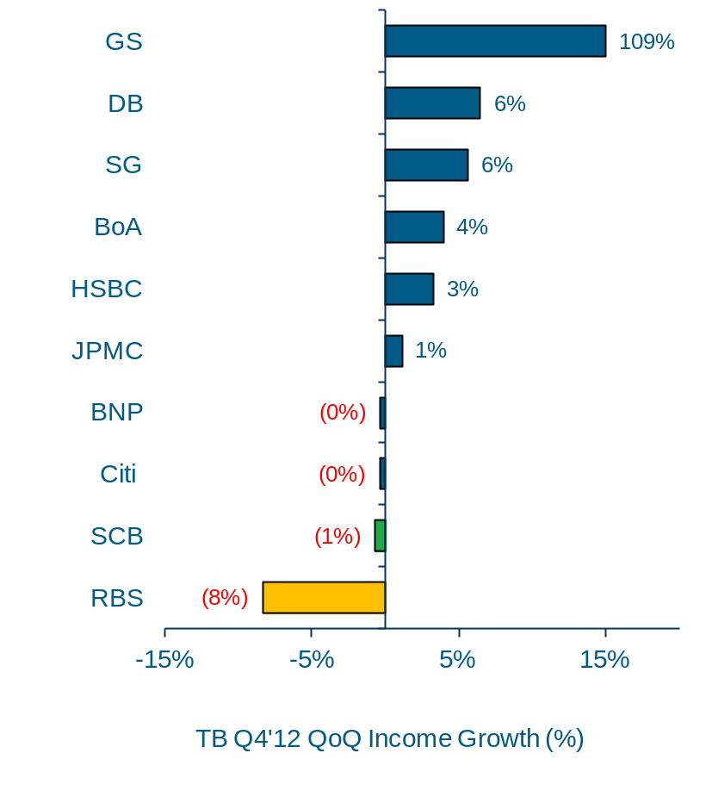
SCB FY’12 Transaction Banking growth of +13% was second highest in the peer group driven by H1 performance
¹
Transaction Banking Income: FY’12 YoY
(%, $m)
Transaction Banking Income: Q4’12 QoQ
(%, $m)
FY'12 Income (US$m)
FY’12 Average YoY Income Growth: +7%
Q4'12 Income (US$m)
Q4’12 Average QoQ Income Growth: +5%
1,986
818
3,671
¹
EXTERNAL VIEW
1,369
11,558
338
Reflecting gain of $500m on the disposal of the firm’s hedge fund administration business in Q4’12. FY’12 YoY growth excl. gain is -7%
Reflecting gain of $500m on the disposal of the firm’s hedge fund administration business in Q4’12. Q4’12 QoQ growth excl. gain is -19%
5,146
1,580
10,677
2,992
1,796
BNPP
2,668
6,190
434
10,857
2,649
1,955
878
1,368
436
Sources: Company reports, WB Performance Management Analysis.
  ¹ SCB total Transaction Banking FY 12 Income on externally reported basis. All other SCB figures on management basis.

Slide 14
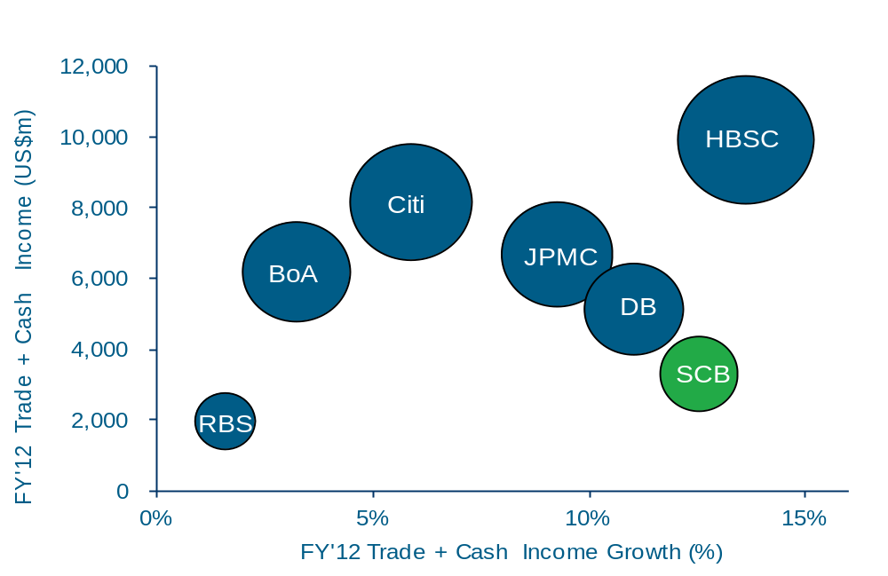
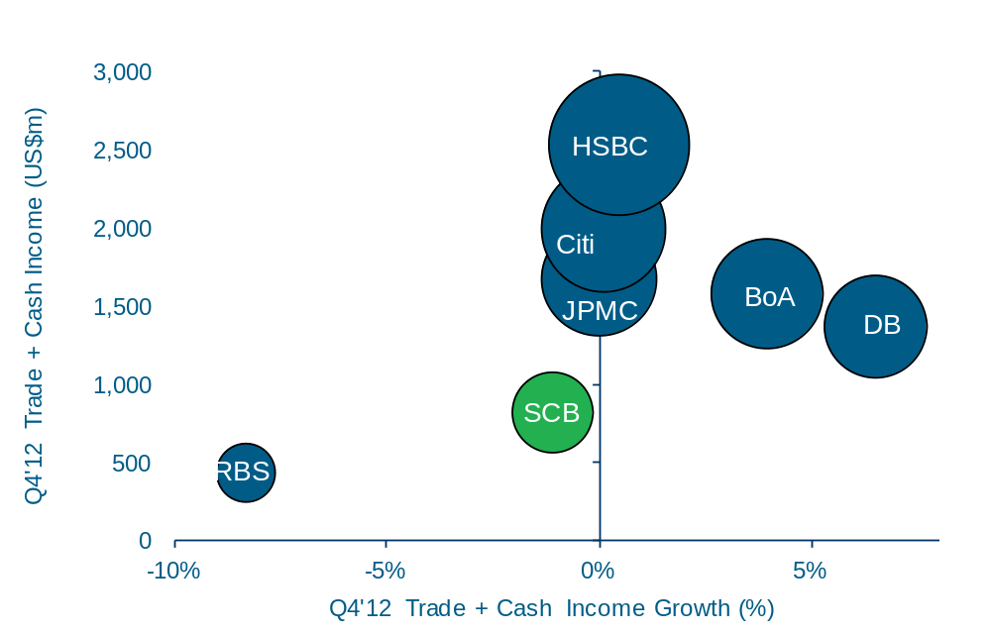
HSBC reported highest YoY growth in Cash and Trade Income²
Cash + Trade Income: FY’12 YoY
(%, $m)
Cash + Trade Income: Q4’12 QoQ
(%, $m)
FY’12 Average YoY Income Growth: +9%
FY’12 Average QoQ Income Growth: +1%
¹
¹
Sources: Company reports, WB Performance Management Analysis. SCB figures on management basis.
  ¹ Deutsche Bank Cash and Trade income includes Securities Services income but for comparative purposes all income is assumed to be Cash and Trade only
  ² SCB are sub-custodians of GS, JPMC and BNPP and therefore do not consider them as competitors.

Slide 15
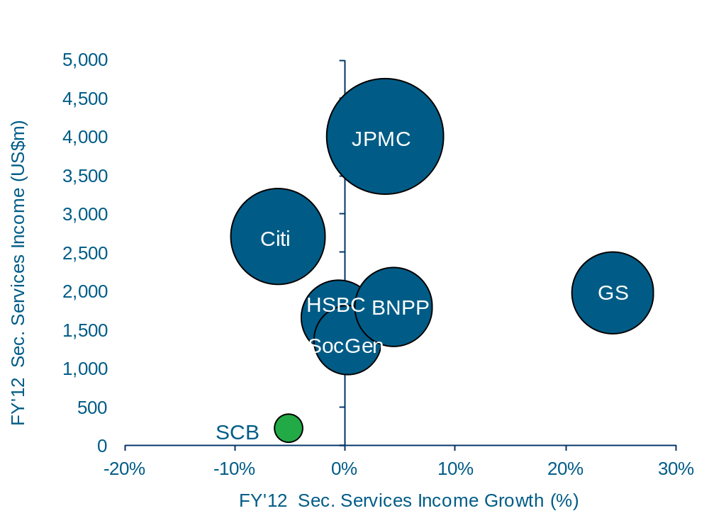
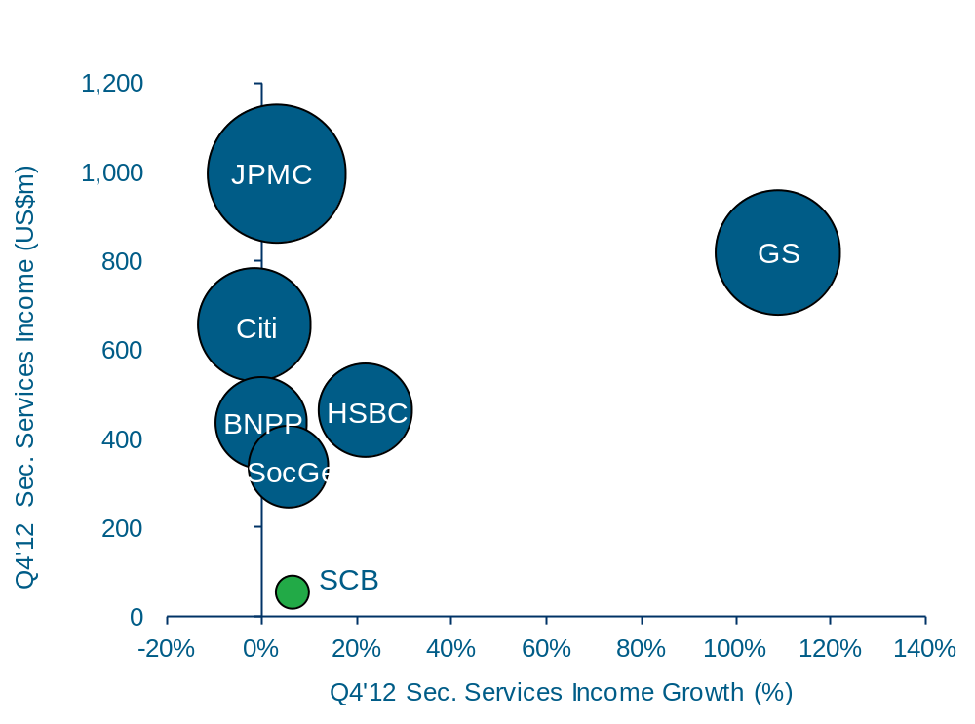
GS Securities Service Income was up +24% YoY
Securities Services Income: FY’12 YoY
(%, $m)
Securities Services Income: Q4’12 QoQ
(%, $m)
FY’12 Average YoY Income Growth: +3%
FY’12 Average QoQ Income Growth: +17%
¹
¹
Sources: Company reports, WB Performance Management Analysis.
1 SCB figures on management basis

Slide 16
Transaction Banking – Performance commentary
  Transaction Banking FY’12 income grew +7% YoY on average across the peer group, driven by Cash Management and Trade which rose +9% YoY on average. FY’12 Securities Services Income rose +3% YoY on average.
  SCB reported the highest FY’12 YoY growth of the peer group (+13%¹), except for GS whose TB business consists of only Securities Services. Trade Finance Income was up +18% driven by balance growth and margin improvements. Cash management Income was up +7% with balance growth offset by flat NIMs and operating account fees. Securities Income was down -5% YoY due to NIM erosion from lower interest rates and exit of the Japan business.
  HSBC FY’12 Income was up +11% YoY with Cash Management income up +14% YoY and Trade Finance income of up +12% YoY. This was offset by a -1% decline in Securities Services income. Within HSBC’s Commercial Banking (‘CMB’) division, International payments volumes grew at twice the rate of the market globally since 2010 with FY’12 income up +15% YoY reflecting new mandates and investments in new products such as HSBCnet mobile. Double digit revenue growth was reported in the UK, Brazil and Hong Kong, all of which are top markets for CMB. Within HSBC’s Global Banking & Markets (GB&M) division, Payments and Cash Management income rose +14% YoY driven by higher average liability balances and increased transaction volumes. HSBC expanded its Global Liquidity Solutions platform within Payments and Cash Management and it is now live in 27 countries. Trade Finance income growth was +11% in CMB and +19% in GB&M. HSBC commented that it has expanded Commodity and Structured Trade Finance offering across CMB and GB&M, establishing new teams in four countries and bringing the total to seven by the end of 2012. Oliver Wyman’s Global Transaction Banking Survey 2012 estimated that HSBC maintained its position as the world’s largest global trade finance bank, increasing its market share of global trade finance revenue from 9% in FY’11 to 10% in H1’12. Securities Services income was impacted by lower net fee income.
  DB FY’12 income was up +11% YoY, driven by continued growth in fee income across products and benefitting from strong volumes. Management reported that Trade Finance benefitted from an ongoing strong demand for financing products, particularly in Europe and Asia region. Income from Trust & Securities Services grew on the back of higher fee income, particularly in the Corporate Trust business in US. Strong transaction volumes and increased deposit volumes drove the growth in Cash Management.
  JPMC, BNPP, BoA, Citi, RBS and SG all reported growth less than the average peer growth rate.
Sources: Company reports, WB Performance Management Analysis. SCB figures on management basis except where stated.
¹ External basis
Notes:
16
16

Slide 17
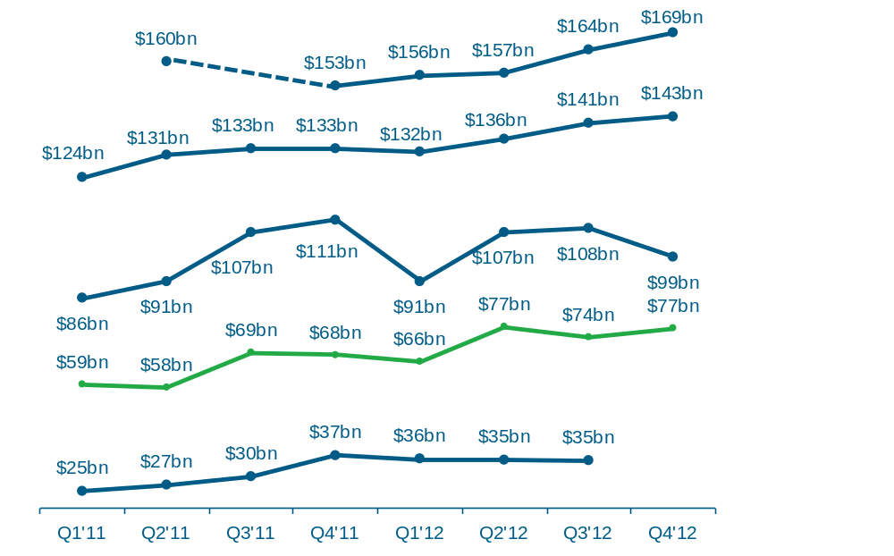
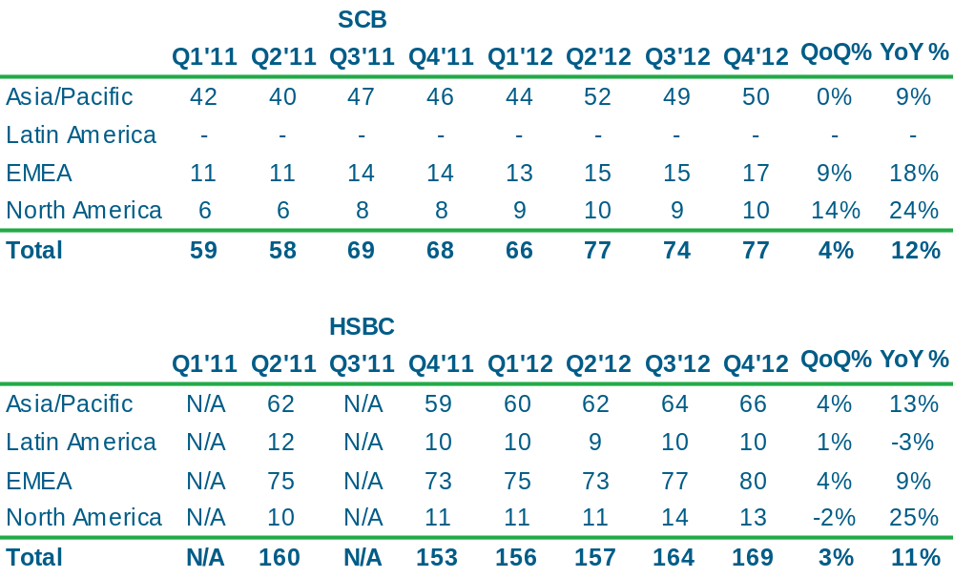
SCB Trade Finance loans saw growth of +12% YoY, with +9% rise in the Asia Pacific region
Q1’11-Q4’12 Total Assets (Transaction Banking Division)
($bn)
Trade Finance Loans by Geography (Period End)
($bn)
HSBC ³
YoY +11%
QoQ +3%
¹
Citi ²
YoY +8%
QoQ +1%
DB
YoY -10%
QoQ -8%
SCB ¹
YoY +12%
QoQ +4%
Driven by maturing of Chinese FI trade loans
JPMC ⁴
Sources: Company reports, WB Performance Management Analysis. SCB figures on management basis.
¹ SCB Latin America trade finance loans included in North America due to booking location
² Refers to period average Total Assets within Transaction Banking division
³ HSBC’s data relates to trade finance loans. Q1’11 and Q3’11 data points not disclosed
⁴ JPMC’s Q4’12 data point not disclosed in FY’12 results announcements

Slide 18
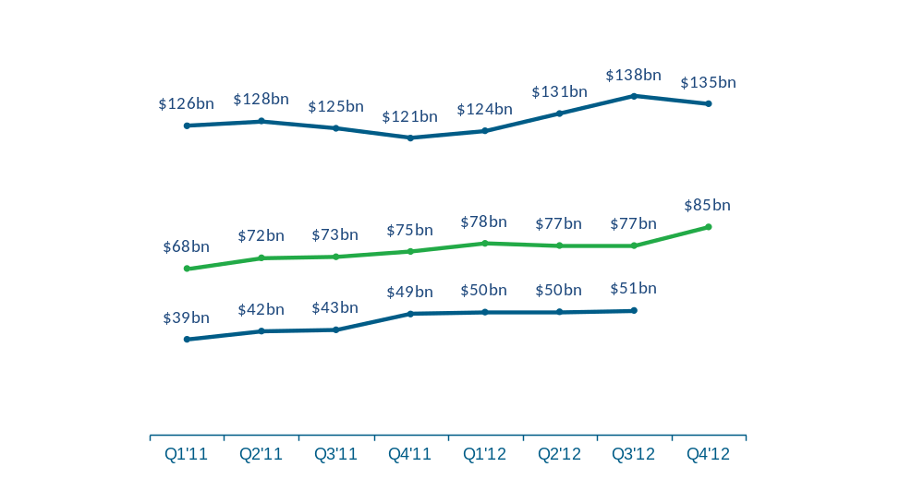
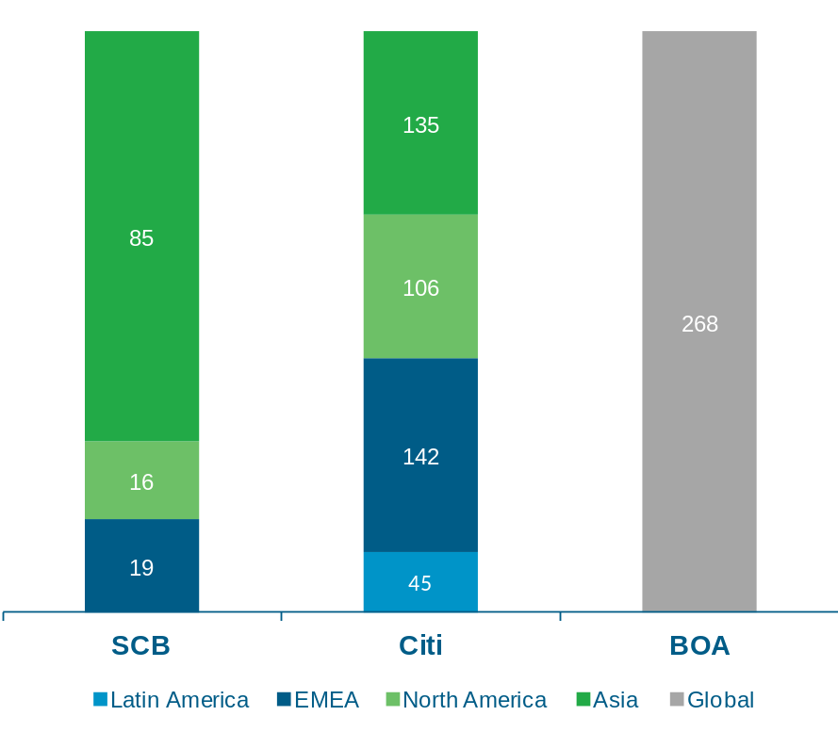
Citi’s TB division average liabilities grew +16% YoY to $428bn. SCB’s Asian TB division average liabilities of $86bn grew +13% YoY
¹
Q4’12 Average Liability Balances by region
(%, $bn)
Average Liability Balances in Asia
(%, $bn)
$120bn
YoY +11%
QoQ +7%
$428bn
YoY +16%
QoQ +3%
$268bn
YoY +11%
QoQ +6%
Citi
YoY +12%
QoQ -2%
YoY: +12%
QoQ: -2%
YoY: +13%
QoQ: +10%
SCB
YoY 13%
QoQ 10%
YoY: +13%
QoQ: -1%
JPMC ³
YoY: +29%
QoQ: -6%
YoY: +20%
QoQ: +8%
YoY: -8%
QoQ: +4%
YoY: +25%
QoQ: +18%
²
Sources: Company reports, WB Performance Management Analysis. SCB figures on management basis.
¹ Average liability balances of Transaction Banking division and where regional split is available
² Latin America balances are included in North America
³ Q4’12 data point not disclosed in FY’12 results announcement

Slide 19
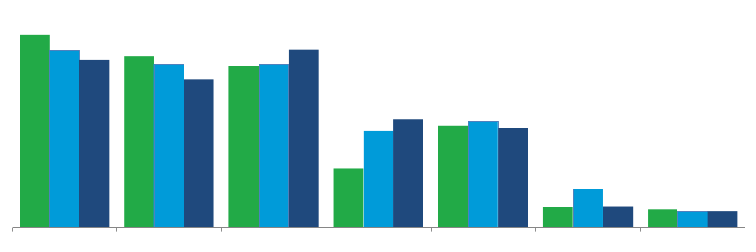
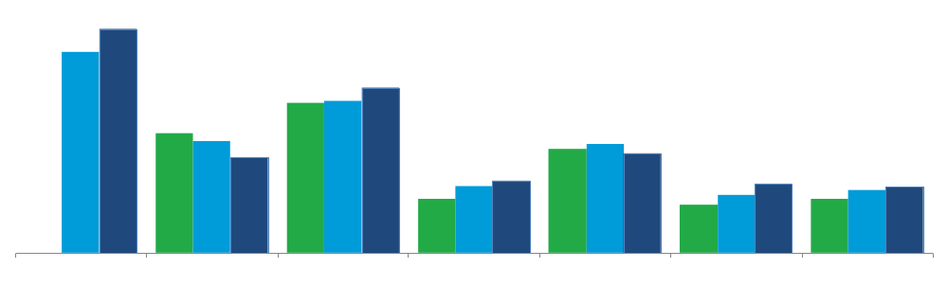
JPMC +11% YoY increase in FY’12 income reflects 10 consecutive quarters of increased loan balances
WB Equivalent Lending Income ($bn)
Highlights
9
  SCB FY’12 WB-Equivalent Lending income of US$0.8bn declined -4% YoY as H1’12 NIMs were squeezed from higher liquidity cost. NIMs recovered in H2 with liquidity easing. Lending assets were strategically held flat.
  BoA FY’12 Income of US$7.8bn was down -5% YoY driven by spread compression, despite lending assets increasing +12%.
  JPMC FY’12 Income of US$5bn increased +11% YoY reflecting the 10th consecutive quarter of increased loan balances driven by stable spreads and strong performance in credit. Lending to commodities companies grew in FY’12 despite a decline in global financing.
  Citi FY’11 Income of US$1.8bn increased +86% due to large gains on hedges as credit spreads widened during the year. FY’12 income of US$1bn was broadly flat against FY’10 reflecting the tightening of credit spreads in 2012 despite consistent growth in assets.
‘10
‘11
‘12
5
1
BOA
RBS
HSBC
JPMC
Barclays
CITI
SCB ¹
WB Equivalent Balance Sheet Lending assets ($bn)
800
‘10
‘11
‘12
600
400
200
N/A
BOA
RBS
HSBC
JPMC
Barclays
CITI
SCB ¹
  ¹ SCB data on Management view

Slide 20
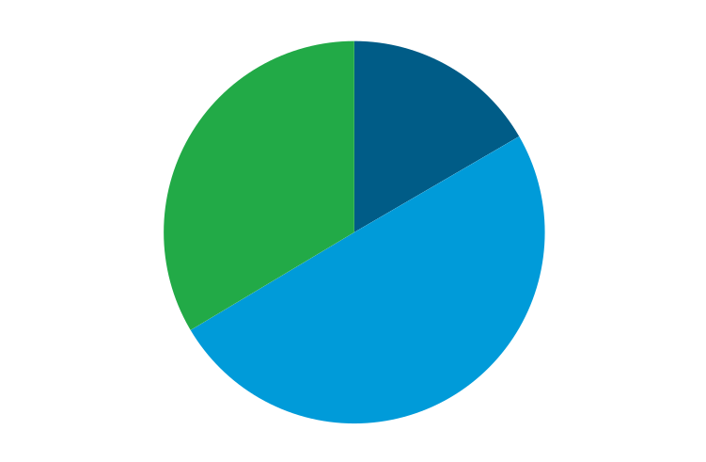
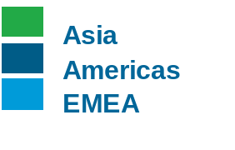
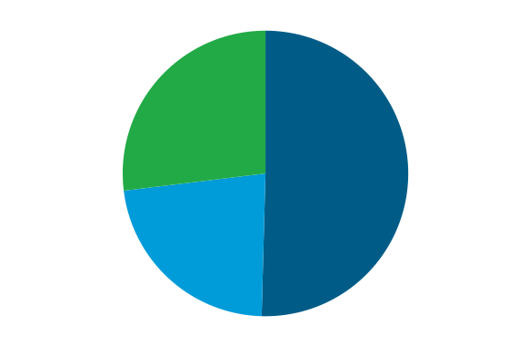
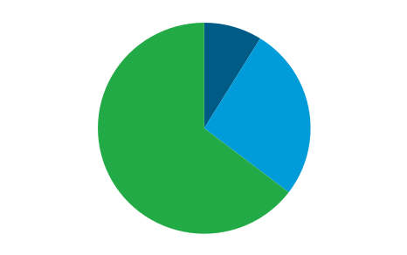
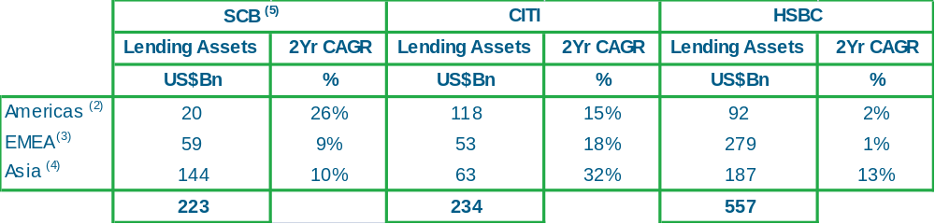
Strong growth in Citi’s WB Equivalent Lending Balance Sheet in Asia
End-2012 WB Equivalent Lending Balance Sheet by Geography ($bn)
Highlights
  Citi had very strong growth in Asia (+32% 2Yr CAGR), which accounts for 27% of their loan portfolio, up from +22% in 2010. The trend matched group investment in Asia – Citigroup opened 65 branches in 2011, mostly in LATAM and Asia. Citi also reported that its deposits and assets under management in Asia hit an all-time high, which is indicative of their continued growth in Asia.
  HSBC’s end-2012 WB Equivalent lending grew by +9% YoY with Asia as the second largest region achieving the highest 2-year CAGR of +13%. HSBC’s focus on corporate and commercial customers that trade internationally resulted in a YoY increase in term and trade-related lending in Asia. HSBC also increased lending to Commercial Banking unit customers in Europe (notably UK) and in North America, reflecting their focus on target segments in the US.
20
92
63
187
59
118
144
53
279
SCB ⁵
CITI ¹
HSBC
Growth by region
2 Yr CAGR / Lending Assets
  Average loans (2) Americas includes North America and Latin America
  EMEA includes Europe , Middle East and North Africa
  Asia includes Hong Kong and Rest of Asia Pacific (5) Management view

Slide 21
WB Equivalent Product Drill Down
FXRC and Commodities

Slide 22
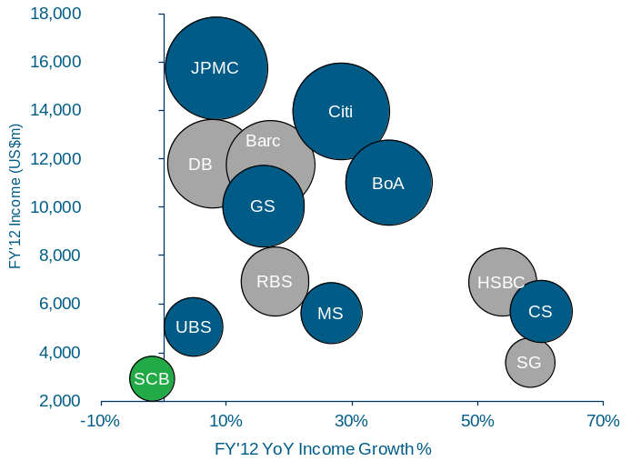
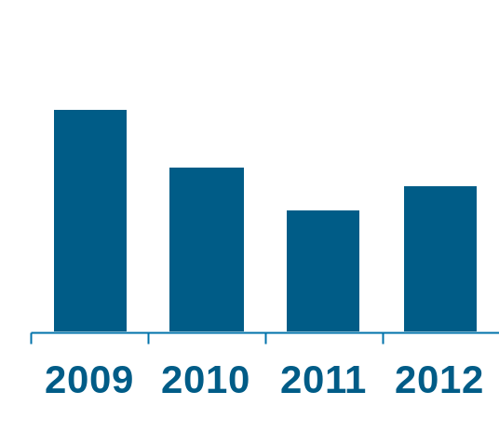
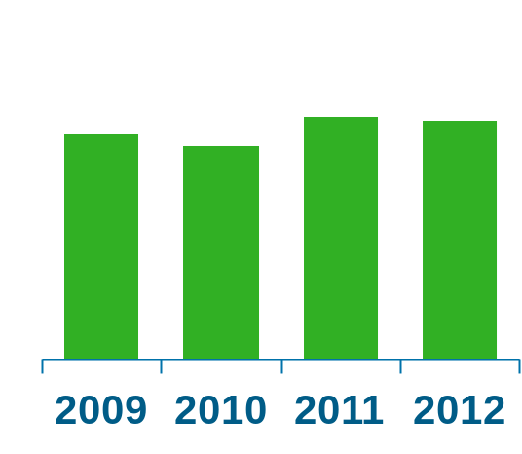
Peer group FXRC&C FY’12 Income growth varied significantly, with FY’12 average growth of +21% across peers from a low FY’11 base
WB-Equivalent FXRC & Commodities Income: FY’12 Ex-CVA/DVA (%, $m)
Highlights
  Peer banks’ growth was from a low base with FY’11 FXRC&C Income the lowest since pre-GFC. FY’09-11 Income CAGR was -26%.
  By contrast, SCB reported its highest ever FXRC&C Income in FY’11. CAGR from FY09-11 was +4%.
  The majority of peers uplift was driven by strong results in Rates & Credit, partially offset by lower FX & Commodities income. For all peers that report a split, the proportion of Rates & Credit from overall FXRC&C income is higher than SCB, in which these accounts for roughly 42%. HSBC Rates & Credit is 53% of FXRC&C, and had an exceptionally strong H1 in both Rates & Credit.
  Credit Suisse (+60%) reported the highest Income growth, driven by a substantial increase in securitised products and global credit products revenues. Greater client demand for higher yielding instruments, and improved results for emerging markets, particularly Latin America, were cited as drivers.
  SocGen (+58%) reported the second highest FY’12 Income growth. Management commented that FY’12 performance was due to an uptick in their Rates and Credit businesses, which benefitted from an increase in issuance volumes and strong client-driven activity.
  HSBC (+54%) reported third highest FY’12 Income growth, driven by a sharp rebound in Rates and Credit driven by improved market conditions particularly in Europe, tightening of spreads and improved investor sentiment following stimuli by central banks globally.
FY’12 Average YoY Income Growth: +21%
WB-Equivalent FXRC & Commodities Income
Peer Group
2009-12 CAGR: (13%)
SCB
2009-12 CAGR: +2%
CAGR +4%
( 2%)
CAGR (26% )
+21%
Sources: Company reports, WB Performance Management Analysis
1 Blue shading indicates figures excluding CVA/DVA.
WB Performance Management - External Performance Analytics
22

Slide 23
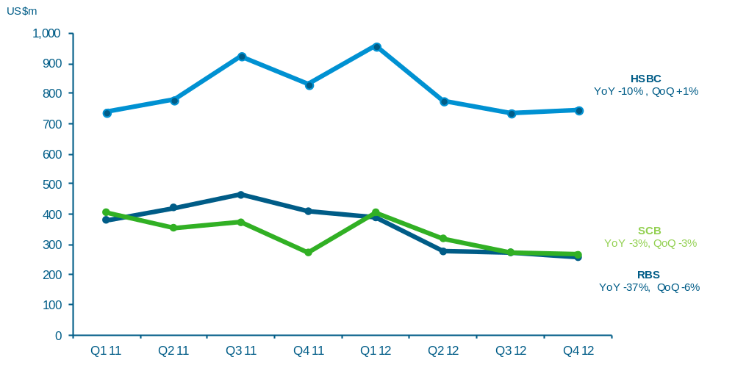
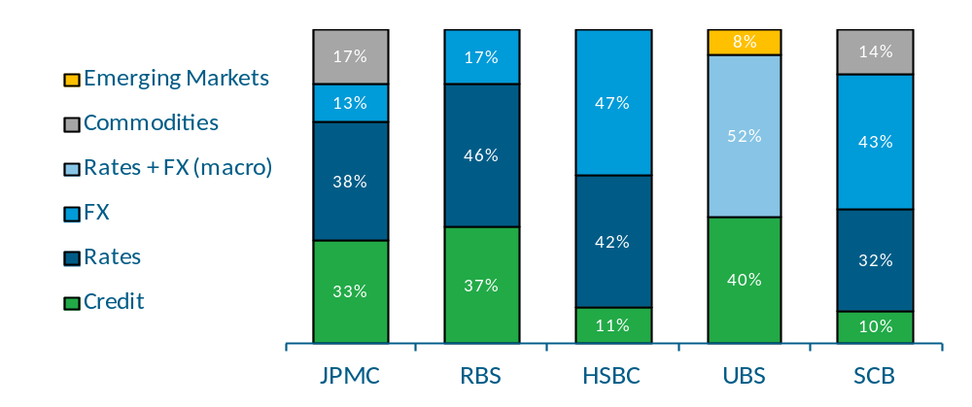
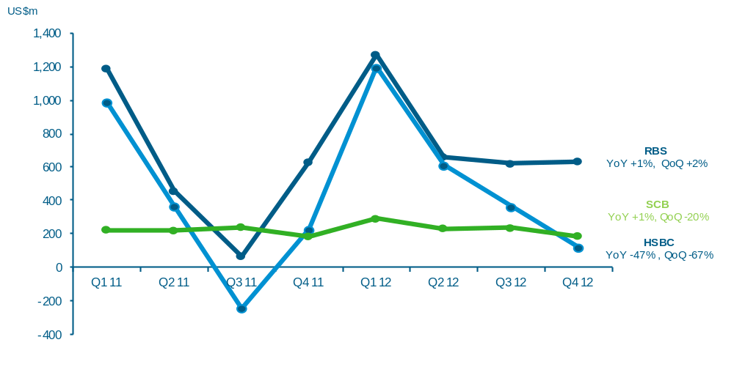
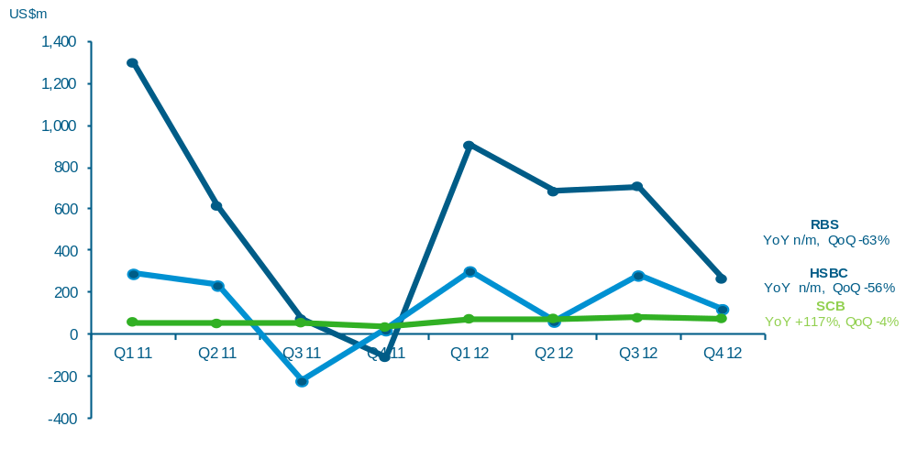
FXRC&C H2’12 income was down on H1’12 across the measurable peer group
FXRC&C Product Mix
FX
FY’12 Total FXRC&C Income ($m)
15,468
6,932
6,912
4,643
2,930
Notable QoQ decline in income across peers
Q4’12 Change
Quarterly income
1
Rates
Credit
Rebound driven by ECB’s LTRO announcement, resulting in improved liquidity, tightening spreads and increased client flow.
Q4’12 Change
Strong rebound in Credit Markets and Asset Backed Products with management citing improving US macroeconomic environment
Q4’12 Change
Quarterly income
Quarterly income
Sources: Company reports, WB Performance Management Analysis. SCB figures on management basis.
¹ UBS product split excludes ‘Other FICC’, which comprises funding and hedging costs. UBS FY’12 FICC income of $4,643m includes ‘Other FICC’ (-$827m).
WB Performance Management - External Performance Analytics
23

Slide 24
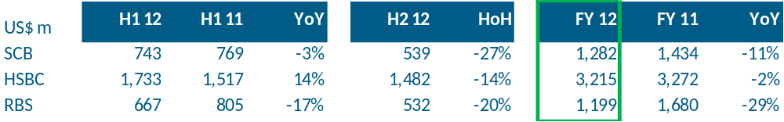
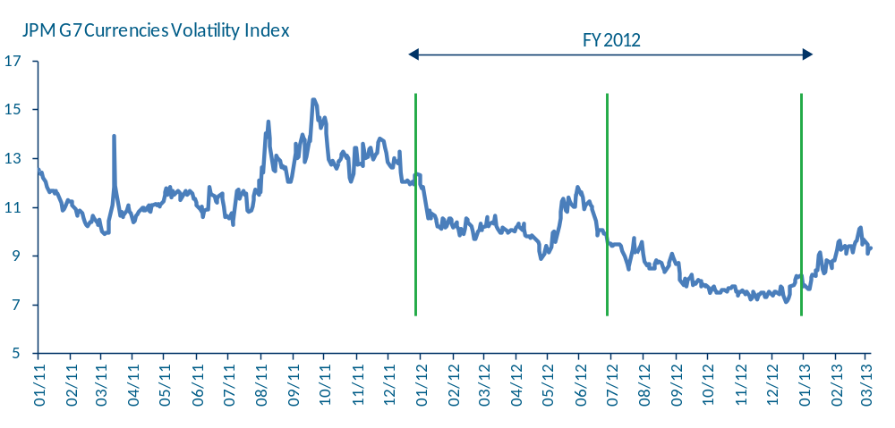
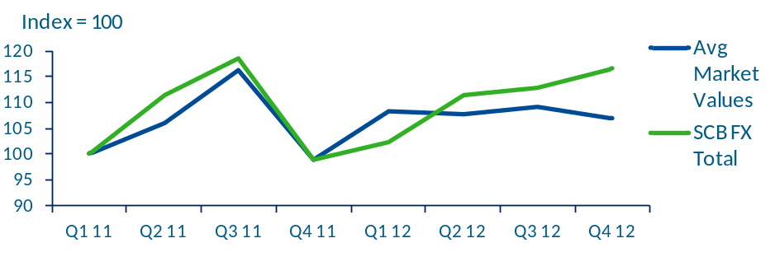
SCB FX income against selected measurable peers
FX Income of Selected Measurable Peers
Highlights
1
  SCB’s H1 FX income declined by -3% YoY as lower average margins (higher proportion of FI clients) more than offset increased volumes. This contrasted with measurable peers:
    HSBC’s +14% YoY growth, particularly in Europe and HK was driven by increased customer activity and higher market volatility. Performance could have been amplified by HSBC’s dominant position in Asia (#1), ranked #5 globally and its FX portfolio weighted towards Corporates (#2 globally) vs. #5 globally for FIs².
    RBS’s FX business “suffered from historically low levels of client activity”.
  SCB’s FX income in H2 decreased -27% HoH driven by margin compression amid higher volumes (notably global corporate volumes).
  HSBC FX HoH Income was also down, driven by reduced client flows and lower market volatility.
  RBS commented on low H2 volumes as a driver of FX income decline.
  The ratio of e-trading to total volume increased further in 2012 from 36.5% to 38.6%³.HSBC’s e-FX income growth was driven by the launch of a real-time online FX margin trading product.
JPM G7 Currencies Volatility Index
SCB FX vs Average Market Value
Sources: Company financial results, presentations and transcripts, Bloomberg, CLS and WB Performance Management Analysis
¹ Peers selected based on externally available information. SCB income data on external basis
² Greenwich Associates – 2013, 2012 and 2011 Greenwich Leaders: Global Foreign Exchange Services. Rankings by market share
³ Euromoney FX Survey 2012 on http://www.euromoney.com/Article/3024863/Euromoneys-2012-FX-survey-results.html

Slide 25
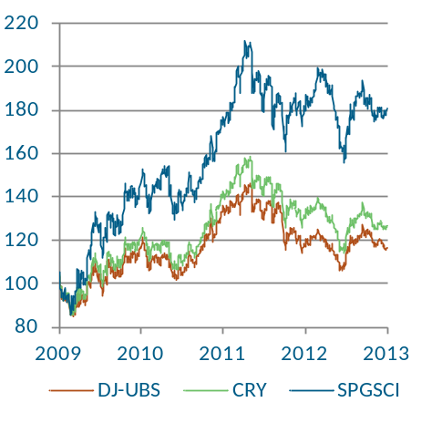
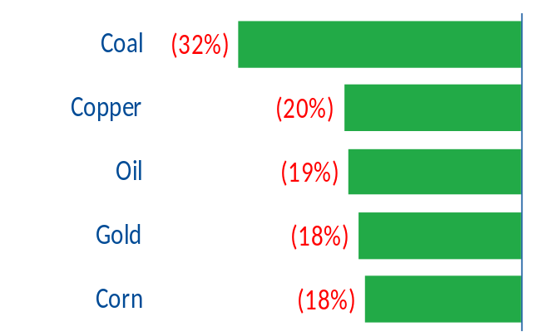
FY’12 Commodities Income for the peer group was impacted by lower price volatility and changing regulation
Key Market Data
Highlights
Key Commodity Indices: 2009-2012
(Indexed to 1 Jan 2009)
Change in Commodity Price Implied Volatility¹
(FY’12 YoY)
  Commodity prices remained high in 2012, although still lower than 2011 levels. Volatilities were, however, significantly lower, impacting client hedging activities.
  Market research estimates by Coalition² reveal that FY’12 Global Commodities income of about $6bn was down -24% YoY. Research published by Tricumen² concluded that total US bank Q4’12 commodities earnings fell by -32% YoY to around $800m - $900m.
  GS FY’12 commodities revenue fell -64% YoY to $575m while MS FY’12 commodities revenue fell by -20%, according to Reuters estimates. The declines were driven by lower market volatility and the impact of the Volcker rule & Dodd-Frank Act on proprietary trading.
  Q4’12 commodities VaR fell -23% YoY at Goldman Sachs and -30% at JPMC. Risk.net reported a -50% reduction of y/e VaR at that Barclays.
  Anecdotal evidence suggests that French banks (BNPP, SocGen and Natexis) are becoming more active in metals and energy, with BNPP identifying APAC in its results as a focus region.
Coal
Copper
Oil
Gold
Corn
Bank | Key Commentary on Bank Commodity Business Models
Barclays | Shut its proprietary agriculture trading operations³
DB | Cut power and natural-gas traders in US and Europe
UBS | Ceased trading in oil, industrial metals and agricultural products as part of its decision to wind down its Fixed Income, Currencies and Commodities division and focus on its commodities index business, which has been placed under the Equities division⁴
MS | Reportedly considering selling parts of its commodities business to Qatar Holding LLC or allowing the unit’s current management (possibly with together with a private equity firm) to buy it out⁵
DBS | CEO commented that the Bank has stepped in to fill the gap left by European lenders and increased its commodities loan book to US$20bn, up from around US$1bn two years ago^{6.} SCB FY’12 commodity loans assets were US$13.5bn.
Sources (unless stated otherwise): Various company reports and company media releases
1 Source: Icedata. Commodity classes selected to reflect key exposures in SCB commodity book. 2 Banks covered by Coalition’s research include GS, JPMC, BoA, Citi, Barc, CS, DB, MS, RBS and UBS. Banks covered by Tricumen’s research include BoA, Citi, GS, MS and JPMC.
3Source: Reuters. 4 Source: Bloomberg.
5 On 15th Oct 2012, the Prime minister of Qatar told reporters that they “are looking at it (the potential acquisition of MS’ commodities business) seriously”
6 As revealed by DBS Group CEO Piyush Gupta at the inauguration ceremony of its new headquarters at Marina Bay Financial Centre on Oct 17th 2012

Slide 26
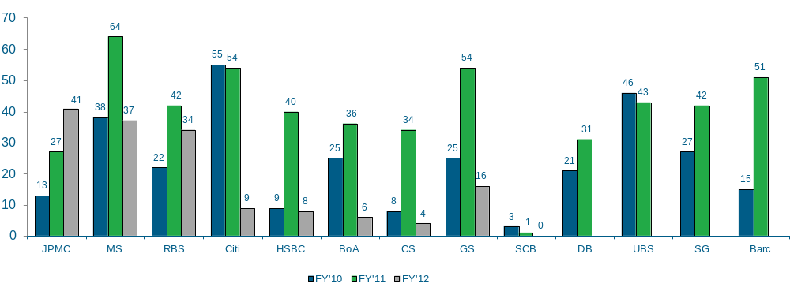
SCB has a consistently lower number of loss-making trading days compared to its peer group
# Loss-making Trading Days per Full Year Period
(# Days: FY’10, FY’11, FY’12)
FY’10 – FY’12 average: 29 days
FY’12 data not yet available
Source: Company reports and for US Banks their respective 10Q/10K filings. SCB data sourced from Financial Markets Business finance

Slide 27
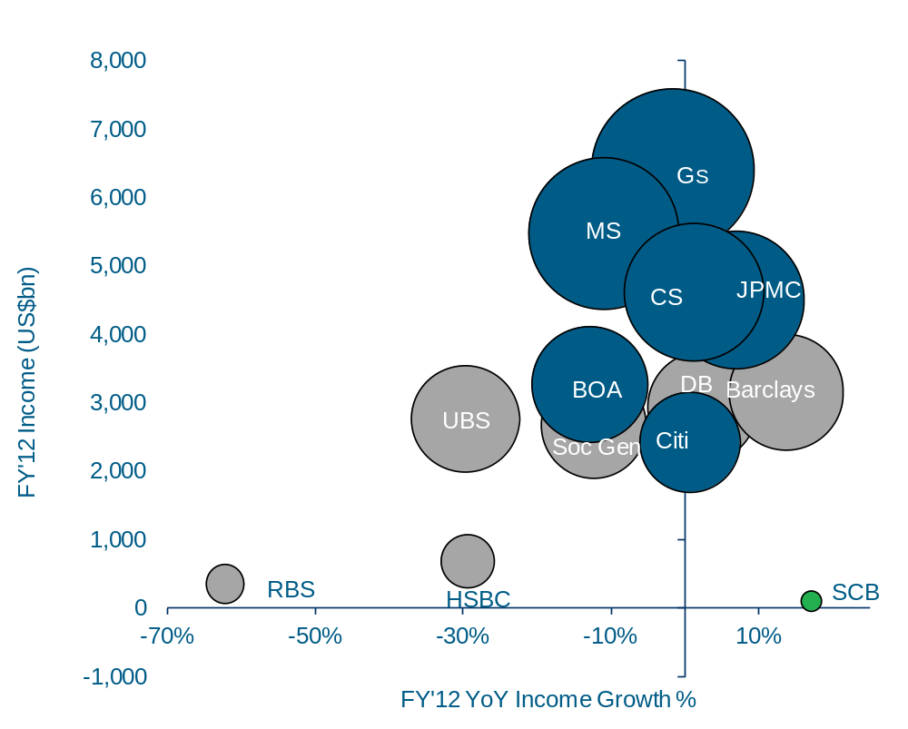
Average FY’12 WB-Equivalent Equities income of peers declined -7% YoY compared to SCB’s growth of +18%
WB-Equivalent Income: FY’12 Ex-CVA/DVA
(US$m and YoY %, Bubble size scaled to FY’12 WB-Equivalent Income)
Highlights
Note: Blue shading indicates figures excluding CVA/DVA
  Excluding SCB, more than half of peers incl. GS, MS, SocGen and HSBC reported lower YoY WB equivalent income, generally reflective of the cash equities market in 2012 – lower volatility compared to 2011 and lack of investor appetite leading to suppressed volumes.
  Despite market conditions, some peers reported that they managed to increase market share e.g. DB in Europe and HSBC within a number of their target emerging markets.
  Barclays achieved the highest growth FY 2012 YoY income (incl. CVA/DVA) of +14% to US$3.2bn among peers excl. SCB, driven by higher market share gains in cash equities and equity derivatives.
  CS’ modest +1% YoY revenue growth (excl. CVA/DVA) was from convertibles, derivatives and prime services, which offset the revenue fall in cash equities.
  RBS was the worst performer reflecting its exit of the cash equities business as part of its deleveraging plans.
FY’12 Average YoY Income Growth -7%
CVA/DVA excluded from BoA, Citi, Credit Suisse, Goldman Sachs, JPMC (only for 2011 ; not disclosed in 2012), Morgan Stanley and UBS. No CVA/DVA disclosure available for Barclays, BNP Paribas, Deutsche Bank and SocGen
Notes:
27
27

Slide 28
WB Equivalent Product Drill Down
Investment Banking
(Capital Markets + Corporate Finance)

Slide 29
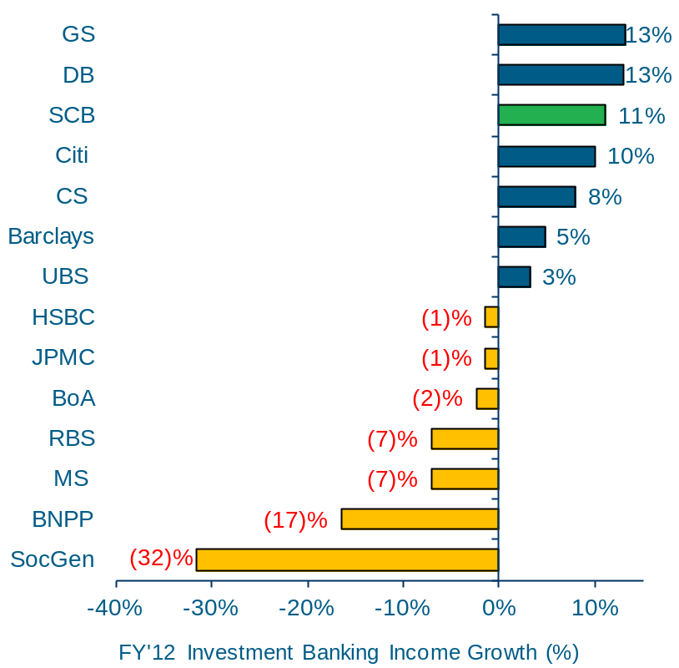
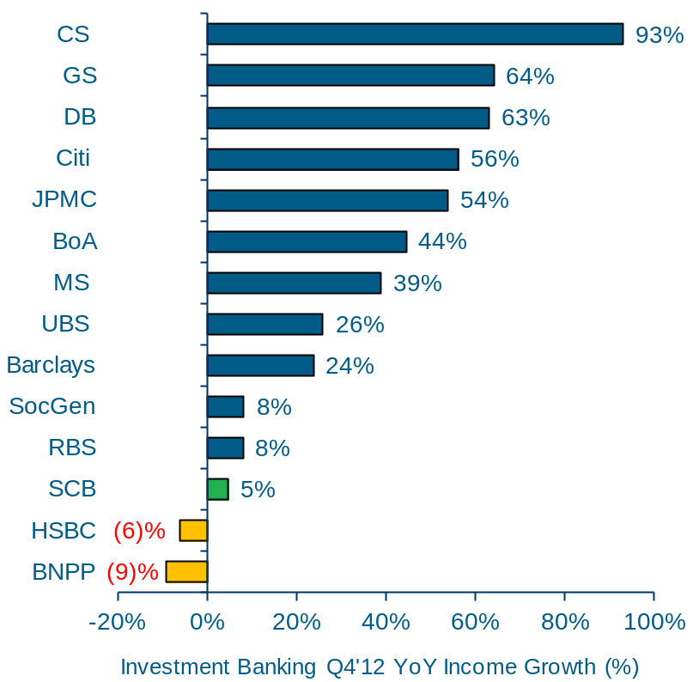
GS reported the highest FY’12 growth vs. the peer group with an average decline of -1% YoY
WB-Equivalent Investment Banking¹ Income: FY’12
($m & YoY %)
WB-Equivalent Investment Banking¹ Income: Q4’12
($m & YoY %)
FY'12 Income (US$m)
Q4'12 Income (US$m)
Q4’12 YTD Average YoY Income Growth: +32%
FY’12 Average YoY Income Growth: -1%
4,926
1,047
3,243
1,405
2,631
900
3,641
996
3,423
1,767
3,364
1,629
2,522
1,225
3,697
700
5,892
992
5,454
560
1,985
518
3,929
755
4,538
²
821
2,032
1,070
2
Sources: Company reports, WB Performance Management Analysis. SCB figures on management basis.
¹ Investment Banking defined as Corporate Finance and Debt and Equity Capital Markets
² BNP Paribas Corporate Finance income consists of the Corporate Bank division. In addition to Structured Finance and Syndications, the Corporate Bank includes Cash Management, Trade Finance and Lending. No breakdown currently disclosed

Slide 30
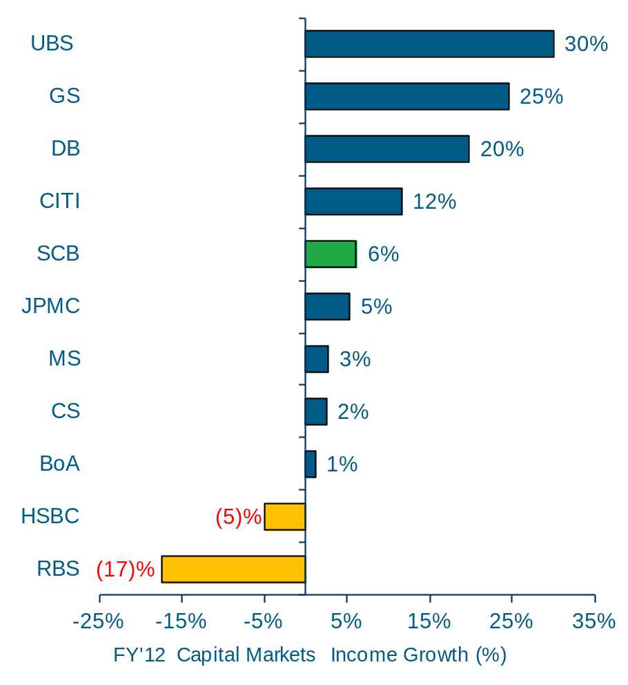
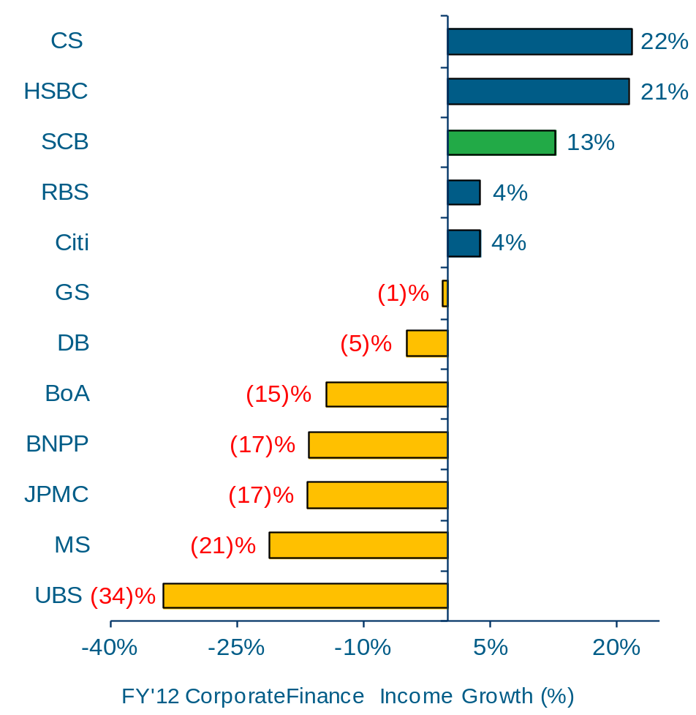
Capital Markets benefited from a strong year end uptick in DCM
WB-Equivalent Capital Markets: FY’12
($m & YoY %)
WB-Equivalent Corporate Finance Income: FY’12
($m & YoY %)
1,842
1,111
2,951
626
2,486
2,057
1,085
FY’12 Average YoY Income Growth: -8%
2,932
709
573
FY’12 Average YoY Income Growth: +7%
1,975
4,369
758
2,560
1,066
2,312
4,538
1
4,388
1,523
3,071
1,369
900
680
Sources: Company reports, WB Performance Management Analysis. SCB figures on management basis.
Note: Capital Markets and Corporate Finance peer group total income and YoY/QoQ changes do not sum to total Investment Banking as Barclays and Socgen do not disclose the split of their Investment Banking business and are therefore excluded from the sub-product level figures.
¹ BNP Paribas Corporate Finance income consists of the Corporate Bank division. In addition to Structured Finance and Syndications, the Corporate Bank includes Cash Management, Trade Finance and Lending. No breakdown currently disclosed
WB Performance Management - External Performance Analytics
30
Notes:
30
30

Slide 31
Investment Banking – Performance commentary
  Capital Markets benefited from a strong year end market wide uptick in DCM driven by persistently low interest rates and quantitative easing exercises by central government across the globe which drove clients to favour funding through capital markets over borrowing.
  GS reported the strongest performance in Investment Banking Income (+13%) driven by Capital Markets (+25%), partially offset by Corporate Finance (-1%). Capital Markets Income growth was driven by recovery from a weak Q4’11 underwriting performance. DCM recorded its second best annual performance and the highest since 2007 due to higher net revenues from investment-grade and leveraged finance activity. ECM Client income was up in Q4’12 YoY but overall down due to low IPO levels. Despite Corporate Finance income down -1%, Goldman Sachs ranked first in worldwide ‘announced and completed M&A’ for 2012.
  DB FY’12 Investment Banking Income was up +13%; Q4’12 Income rose +63% YoY driven by recovery from a weak Q4’11 underwriting performance. DCM Income was up +34% YoY due to higher net revenues from corporate debt issuance, with ECM income down -7% YoY due to low equity underwriting activites. Corporate Finance Income was down -5% YoY driven by lower M&A activity.
  Morgan Stanley FY’12 Investment Banking Income was down -7% YoY driven by -21% decrease in Corporate Finance Income, this was partially offset by +3% uptick in Capital Markets Income in FY’12 driven by strong demand for capital markets funding. DCM income was up +23% YoY, offset by -21% YoY decrease in ECM revenue driven by low IPO levels.
  French banks BNPP & SocGen FY’12 investment banking income was down -17% and -32% respectively. BNPP decline was driven by limited client demand, reduced transactions volume and low volatility in 2012. Management commented that BNPP did, however, maintain a solid position, ranking number 3 as bookrunner for equity-linked products in Europe.
  SocGen was marked by the negative impact of their loan disposal programme (de-risking). In FY’12 $12.8bn loans were sold at a $628m discount compared to FY’11, where $8.3bn loans were sold at a $227m discount. Excluding the impact of loans sold at a discount, Income declined -17% YoY. Management commented that structured financing activities were “resilient” in 2012 thanks to natural resources, export and infrastructure financing. Capital market activities posted mixed results, with a “good” performance in DCM, which benefitted from a strong year end market wide uptick, whereas ECM was hit by “low” volumes.
  Market overview: FY’12 Global Debt Capital Markets volume rose +6% YoY to a total value of $4.9tn while Q3’12 volumes dropped -24% QoQ to $1.5tn. YTD Q3’12 Global M&A deal value fell -17% YoY to $1.8tn, Q3’12 volumes dropped -18% YoY to its lowest quarterly total since Q3’04. Cross border made up 34% of total volumes in Q3’12, the highest since Q3’04. Global Equity Capital Markets deal volumes rose +77% YoY in Q3’12, with September’s volume of $90.4bn being the biggest month since December ’10. Despite quarterly increase, YTD Q3’12 volumes dropped -10% YoY to $480bn.
  Peer Group Commentary YTD YoY: Total WB Equivalent Investment Banking Income fell -10% YoY with Capital Markets income down -6% and Corporate Finance income down -15%. SCB (+14%) was the strongest performer with Corporate Finance YoY growth of +14% and Capital Markets of +14%.
  UBS reported the highest YoY growth in Capital Markets (+18%) driven by +27% growth in ECM due to increased participation in private and structured transactions from Q2’12 and +10% growth in DCM. This was offset by a -35% decline in its Advisory business due to decline in fees revenue.
  SocGen’s Q3’12 YTD Income fell -40% YoY due to an ongoing increased cost of loan disposals.
  Peer Group Commentary YoY: Investment Banking income rose +20% YoY on average with a strong uptick in Capital Markets, particularly in Debt Capital Markets, which grew +43% partially offset by a -5% decline in Corporate Finance income.
  DB reported the strongest performance (+80%) driven primarily by its Debt Capital Markets, which grew +123% YoY due to an increase in corporate debt issuance. Equity Underwriting grew +106% YoY driven by an industry-wide increase in activity, particularly in North America.
  MS’s Q3’12 Capital Markets Income rose +40% YoY driven by a +103% increase in Debt underwriting income due to increased bond issuance volumes and higher market share in investment grade debt. This was partially offset by a -18% in Corporate Finance due to lower completed market volumes.
Sources: Company reports, WB Performance Management Analysis. SCB figures on management basis.
Note: Capital Markets and Corporate Finance peer group total income and YTD/YoY changes do not sum to total Investment Banking as Barclays and Socgen do not disclose the split of their Investment Banking business and are therefore excluded from the sub-product level figures.
Notes:
31
31

Slide 32
Balance Sheet Metrics

Slide 33
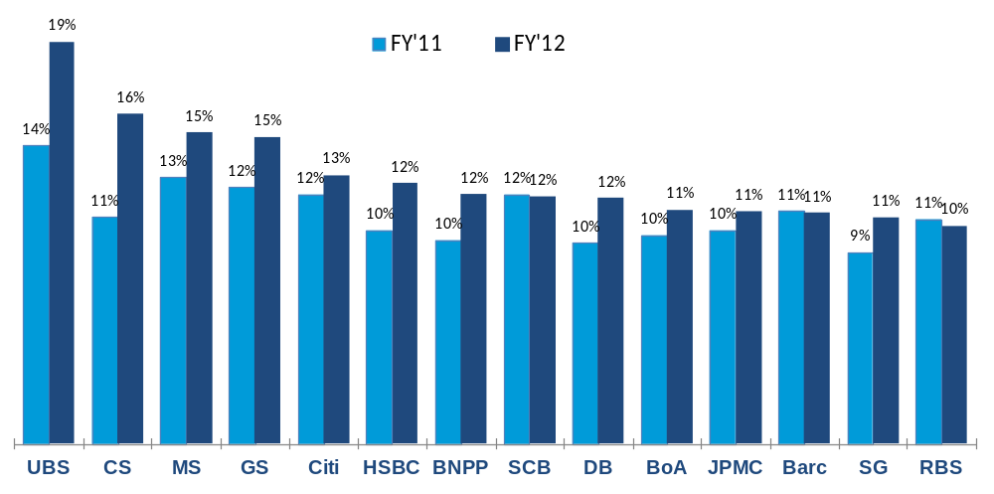
Capital ratios rose for most banks in the peer group
Growth in Group Core Tier 1 Ratios^{1,2}
Highlights
  UBS and Credit Suisse reported the highest and most YoY improved (+490bps) Group Core Tier 1 ratios at end-2012, from capital retention and reduction in RWAs due to deleveraging.
  UBS reduced RWAs by -20% YoY at end-2012, the largest across the peer group as they accelerated their deleveraging plans (see next slides for more details).
  SCB and JPMC were the only banks in the peer group to report higher RWAs at end-2012 mainly from asset growth and regulatory changes to capital models.
  Core Tier 1 ratios decreased marginally for SCB, Barclays and RBS.
-20%
-7%
-3%
-12%
0%
-7%
-10%
+12%
-12%
-6%
+4%
-1%
-7%
-9%
FY’12 YoY change in RWAs
Increase / (Decrease)
¹ Most peers do not disclose their capital positions/ratios at WB level, hence data at Group level has been used for comparison purposes.
² US banks report under Basel 1 while European banks under Basel 2.5.
WB Performance Management - External Performance Analytics
33

Slide 34
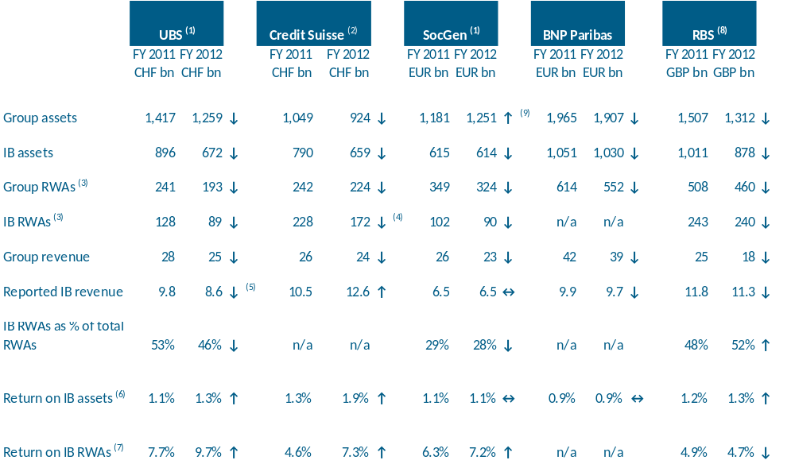
Aggressive deleveraging drove lower revenues but succeeded in increasing returns on RWAs and assets
  Deleveraging of European banks was in response to Basel 2.5/3 requirements that significantly impacted IB divisions and increased the overall amount of capital and liquidity required.
  Deleveraging drove down Group and IB revenues except for Credit Suisse. This trend was reflected in Credit Suisse’s 2011 results when they initiated a risk reduction plan in mid-2011, accelerating it in Q4 2011.
  UBS and RBS ran down legacy portfolios while SocGen, BNPP and RBS engaged in asset sales e.g. loans and non-core businesses. UBS also exited/significantly reduced lines of business e.g. FICC macro directional trading, asset securitisation and complex structured products:
    UBS reduced B3 RWAs mainly in FICC credit and rates, which led to a reduction in FICC revenues.
    SocGen’s impact from deleveraging was c. -€0.8bn on net income.
    Excluding the impact from loan sales, BNPP’s CIB revenues fell 10% yoy (€ 1.1bn) in line with the expected impact of deleveraging (mainly in Corporate Banking).
  Excluding RBS, average return on RWAs for the sample peer group increased by 1.9bps. RBS’ decline was driven by higher RWAs in UK Corporate and International Banking as a result of regulatory model changes/uplifts.
Financial metrics of selected peers
Sources: Company quarterly financial results, presentations and transcripts and WB Performance Management Analysis
⁽¹⁾ IB data relates to the core investment bank ⁽²⁾ US GAAP ⁽³⁾ Basel 2.5 ⁽⁴⁾ Basel 3
⁽⁵⁾ Excluding -CHF1.85bn impact from unauthorised trading incident ⁽⁶⁾ IB revenue divided by year-end IB assets
⁽⁷⁾ IB revenue divided by year-end IB RWAs ⁽⁸⁾ RBS’ IB division is assumed to be the sum of UK Corporate, International Banking and Markets divisions
⁽⁹⁾ SocGen's asset increase was driven by cash, due from central banks and financial assets at FV through P&L, mainly in the trading portfolio (shares, other equity securities and financial assets)

Slide 35
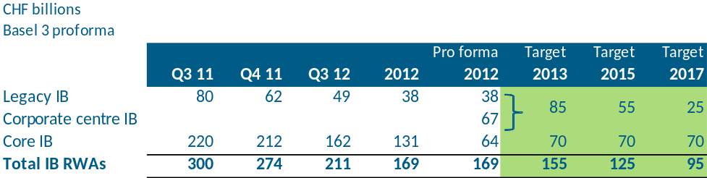
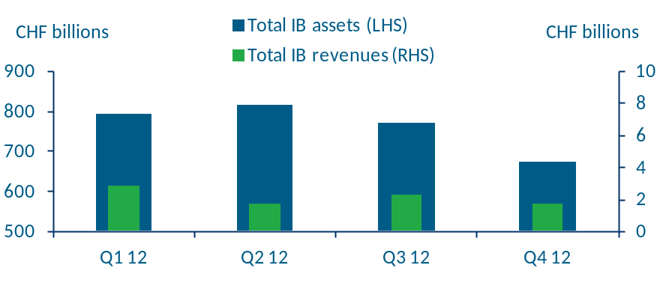

Deep dive: UBS – IB revenue impact from deleveraging
UBS Investment Bank RWAs
  UBS accelerated their deleveraging strategy (principally in FICC) in October 2012 and reduced IB assets by c. -40% to CHF672bn at end-2012 and IB B3 RWAs by -CHF131bn (-44%) since Q3’11. FY 2012 IB revenues declined by -CHF1.3bn (-13%) yoy.
  UBS achieved core IB B3 RWAs of CHF64bn at end-2012, meeting 2013 targets.
  In Q4 2012, B3 RWAs declined by CHF 31bn vs. Q3, which was achieved largely in FICC Credit and Rates:
    Rates revenues declined significantly in Q4 vs. Q3, particularly in long-end and non-linear interest rates, as a result of exiting or downsizing products.
    Revenue from Credit flow trading and structured credit declined in line with expectations from reduction in RWAs.
    Emerging markets revenues declined -CHF111m to -CHF4m, across all regions in preparation for ultimately exiting those businesses.
  Management will continue with deleveraging plans by further sharpening its focus in the IB, reducing costs while driving further efficiencies across the Group more rapidly. Annual cost savings targets were increased from c. CHF3.4bn to CHF5.4bn in 2015. UBS is expected to have FTEs of c. 54,000 by 2015.
  UBS aims to progressively return capital to shareholders targeting B3 CET1 ratio of 13% in 2014 and RoE of >15% from 2015.
(1)
UBS Investment Bank asset and revenue trends
Sources: UBS Strategy Day November 2011 and company quarterly financial results, presentations and transcripts
⁽¹⁾ c. CHF67bn B3 RWAs from non-core IB was transferred to the Corporate Centre at end-2012, which will ultimately be exited

Slide 36
FY’12 FX & Investment Banking League Tables

Slide 37





TO UPDATE IF AVAILABLE
FX rankings by geography
Market share by geography – 2010
Market share by geography – 2011
Market share by geography – 2012
Estimated market share by clients in Asia (excl. Japan, Australia and New Zealand) – 2012
Sources:
Greenwich Associates – 2013, 2012 and 2011 Greenwich Leaders: Global Foreign Exchange Services
Greenwich Associates report for SCB – Foreign Exchange Services – Asia (excl. Japan, Australia and New Zealand): Research Highlights for Corporates and Financials, 2012

Slide 38




TO UPDATE IF AVAILABLE
FX rankings of selected peers by market share
Global – overall
Global – corporates
  Slowdown in trading activity in 2012 resulted in a YoY decline in FX revenues. E.g. SCB (-11%), HSBC (-2%), UBS (-6%) and RBS (-29%).
  DB, Citi and UBS, the top 3 dealers, demonstrated momentum in FX trading in 2012 with significant gains in market share. E.g. UBS gained market share particularly among financials and partially as a result of its strong electronic trading capabilities.
  The strength of the world’s leading FX dealers can be attributed in large part to the breadth of their worldwide capabilities.
    UBS and DB enjoy a commanding lead in Europe.
    UBS and Citi are tied for market share lead in the US.
    In Asia (excl. Japan, Australia and New Zealand, HSBC is dominant with Barclays and Citi tied for second.
Asia (excl. Japan, Australia and New Zealand) – overall
Global – financials
Sources: Greenwich Associates – 2013, 2012 and 2011 Greenwich Leaders: Global Foreign Exchange Services

Slide 39




DCM – Bookrunner Parent FY’12 Market Overview
TO UPDATE
Global Markets DCM
Quarterly Deal Values (US$bn) (Q1’09-Q4’12) No. Of Deal #
Emerging Markets DCM
Quarterly Deal Values (US$bn) (Q1’09-Q4’12) No. Of Deal #
Highlights
  Global DCM volume reached $6.5tr in 2012, up 11% compared with the $5.8tr issued in 2011 and the second highest volume on record behind 2006 ($6.6tr). H1’12 accounted for 52% of the year’s total with $3.4tr while H2’12 volume dropped to $3.1tr although this was still up 32% on H2’11.
  Deal activity fell to 23,786 deals from 24,437 deals in 2011, the lowest deal count since 2009 (21,123). Average deal size rose 17% to $274m.
  Global DCM revenue reached $21.2bn in 2012, up 30% on 2011 and on par with the record set in 2006. DCM accounted for 32% of total IB revenue, the most since 1998.
  Asia Pacific (ex-Jpn,Australia,China) DCM volume reached $394bn in 2012, up 25% on 2011 ($314bn). Activity of 2,454 deals was down marginally (-2%), with an average deal size of $161m, up 28% from 2011.
  JP Morgan led the global DCM bookrunner ranking in 2012 with a 7.1% market share, followed by Deutsche Bank and Barclays with 6.1% each.
Asia (ex-Jpn,Australia,China) DCM
Quarterly Deal Values (US$bn) (Q1’09-Q4’12) No. Of Deal #
Middle East DCM
Quarterly Deal Values (US$bn) (Q1’09-Q4’12) No. Of Deal #
Source: Dealogic
Notes:
39
39

Slide 40





TO UPDATE
DCM – Top Banks By Region
Global Markets DCM
Top 6 banks , FY’12 with market share and ranking for FY’11 and FY’10
Emerging Markets DCM
Top 6 banks , FY’12 with market share and ranking for FY’11 and FY’10
FY’12 SCB ranked #32 with 0.6% of market share
FY’12 SCB ranked #7 with 2.5% of market share
Asia (ex-Jpn,Australia,China) DCM
Top 6 banks , FY’12 with market share and ranking for FY’11 and FY’10
Middle East DCM
Top 6 banks , FY’12 with market share and ranking for FY’11 and FY’10
Source: Dealogic
Notes:
40
40

Slide 41




M&A – Bookrunner Parent Q1’13 market overview
TO UPDATE TEXT
Global M&A
Quarterly Deal Values (US$bn) (Q1’10-Q1’13), No. Of Deals (#)
Emerging Markets M&A
Quarterly Deal Values (US$bn) (Q1’10-Q1’13), No. Of Deals (#)
Highlights
  Q1’13 Global M&A volume increased +18% YoY to $690.3bn (driven by three competing deals for Dell), while deal numbers were lower -26% YoY.
  Q1’12 was the weakest first quarter since 2003 and the third successive quarter of decline, decreasing -8% QoQ.
  The Americas was the only region to see a YoY increase (+58%) to $391.1bn in Q1’13.
  North America region had the highest volume of M&A activity in Q1’12 accounting for 39% of total volume followed by Western Europe and APAC with 30% and 23% respectively.
  Basic Materials was the most active sector in Q1’12 primarily driven by Glencore.
Asia (ex- Japan, Australia, China) M&A
Quarterly Deal Values (US$bn) (Q1’10-Q1’13), No. Of Deals (#)
Middle East M&A
Quarterly Deal Values (US$bn) (Q1’10-Q1’13), No. Of Deals (#)
Source: Dealogic
Notes:
41
41

Slide 42




M&A – Q1’13 top banks by region
Global M&A¹
Top 6 banks, Q1’13 with market share and ranking for Q1’12, Q1’11 and Q1’10
Emerging Markets M&A¹
Top 6 banks, Q1’13 with market share and ranking for Q1’12, Q1’11 and Q1’10
Q1’13 SCB ranked #153 with 0.03% market share
SCB ranking not available
Asia (ex- Japan, Australia and China) M&A¹
Top 6 banks, Q1’13 with market share and ranking for Q1’12, Q1’11 and Q1’10
Middle East M&A¹
Top 6 banks, Q1’13, with market share and ranking for Q1’12, Q1’11 and Q1’10
SCB ranking not available
SCB ranking not available
Source: Dealogic
¹ Sum of market share of the Top 6 banks is greater than 100% as a deal includes more than one financial advisor
² National Bank of Abu Dhabi
Notes:
42
42

Slide 43




ECM– Bookrunner Parent FY’12 Market Overview
TO UPDATE
Global Markets ECM
Quarterly Deal Values (US$bn) (Q1’09-Q4’12) No. Of Deal #
Emerging Markets ECM
Quarterly Deal Values (US$bn) (Q1’09-Q4’12) No. Of Deal #
Highlights
  Global ECM volume totaled $661bn via 4,251 deals in 2012, up 5% from 2011 ($630bn).
  Global ECM revenue reached $13.6bn in 2012, the lowest total since 2003 ($11.4bn). Despite the overall drop, revenue of $7bn in H2’12 was up 38% on H2’11 ($5.1bn) and up slightly on the first half of the year ($6.5bn).
  Global IPO volume of $124bn (795 deals) was down 27% on 2011 and the lowest annual volume since 2009 while activity fell 40% year-on-year. Facebook’s $16bn deal was the year’s largest IPO and accounted for 13% of volume.
  Goldman Sachs led the global ECM bookrunner volume ranking with $59bn and an 8.9% share, followed by Citi.
Asia (ex-Jpn,Australia,China) ECM
Quarterly Deal Values (US$bn) (Q1’09-Q4’12) No. Of Deal #
Middle East ECM
Quarterly Deal Values (US$bn) (Q1’09-Q4’12) No. Of Deal #
Source: Dealogic
Notes:
43
43

Slide 44




TO UPDATE
ECM– Top Banks By Region
Global Markets ECM
Top 6 banks FY’12, with market share and ranking for FY’11 and FY’10
Emerging Markets ECM
Top 6 banks FY’12, with market share and ranking for FY’11 and FY’10
FY’12 SCB ranked #62 with 0.2% of market share
FY’12 SCB ranked #34 with 0.5% of market share
Asia (ex-Jpn,Australia,China) ECM
Top 6 banks YTD Q3’12, with market share and ranking for FY’11 and FY’10
Middle East ECM
Top 6 banks FY’12, with market share and ranking for FY’11 and FY’10
FY’12 SCB ranked #16 with 0.9% of market share
SCB ranking not available
Source: Dealogic
N.A: Not applicable as they did not make any deals for the respective year
Notes:
44
44

Slide 45
Methodology and Key Assumptions

Slide 46
TO UPDATE
WB Equivalent Methodology and Assumptions – Global Peers
 | Bank | Methodology and Assumptions
Income | All banks | SCB WB global and headline data is presented on external basis. SCB product level data is presented on management basis. Peer group WB-Equivalent and Group level data is presented on external basis.
 | Bank of America | Global Banking + Global Markets
 | Barclays | Investment Banking + Corporate Banking
 | BNP Paribas | Corporate & Investment Banking + Investment Solutions (Securities Services business only)
 | Citi | Securities Banking (ex-Private Banking) + Transaction Services
 | Credit Suisse | Investment Banking
 | Deutsche Bank | Corporate Banking & Securities + Global Transaction Banking
 | HSBC | Global Banking & Markets + 95% Commercial Banking (ex-insurance)
 | Goldman Sachs | Investment Banking + Institutional Client Services + Investing &Lending
 | JPMorgan Chase | Corporate & Investment Bank + Commercial Banking + Private Equity (Private Equity business line only)
 | Morgan Stanley | Institutional Securities
 | RBS | International Banking + Markets + UK Corporate
 | Société Générale | Corporate & Investment Banking + Private Banking, Global Investment Management and Services (Securities Services and Brokers only)
 | UBS | Investment Bank
Expense | All banks | WB-Equivalent expense allocation is based on reported divisional Expenses, except where listed below
 | Citi | Private Bank Expenses are stripped out of WB-Equivalent figures based on industry average private bank cost:income ratio
 | JPMorgan Chase | Corporate & Investment Bank + Commercial Banking + Private Equity (Private Equity business line only)
Other | All banks | CVA/DVA charges are separated from underlying Income where disclosures available Non-core/run-off portfolio Income and Expenses are excluded for RBS, Citi and Société Générale WB-Equivalent analysis WB-Equivalent Profit/(Loss) Before Tax includes Share of Earnings of Associates and JVs, and loss on disposal

